Slide 1
How to Write and Publish A Scientific Paper
Dr. Entidhar Al-Taie

Slide 2
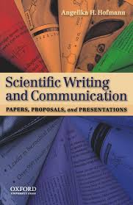
References
• Day, R.A. and Gastel, B.,2010,How to Write
and Publish a Scientific Paper, 7th Ed.,
Cambridge Un. Press.
• Hofmann, A.H.,2010, Scientific Writing and Communication, Oxford Un. Press.
Jansson, R. (2013). English for Scientific
Research: A Practical Guide to Good Science
Writing, Studentlitteratur, Lund

Slide 3
What is Scientific Paper?
An acceptable primary scientific publication must be the first disclosure containing sufficient information to enable peers (1) to assess observations, (2) to repeat experiments, and (3) to evaluate intellectual processes.
Therefore a scientific paper is:
– The first publication of an original research results.
– Peers of the author can repeat the experiment.
– In journal or other source available for scientific community.
– The paper had been peer reviewed before publication.

Slide 4
A scientific paper is really three (3) separate papers. This fact is critically important when you set out to write a paper, or to read one.
Title: Fishing for readers
Abstract: The “Reader’s Digest” version
The body of the paper: The whole story

Slide 5
Different Types of Scientific Writing
Similar principles apply to any type of scientific writing, but the purpose and constraints may be different
Review article
Thesis
Book: ~ thesis
Report
Conference papers
Technical papers
Case Studies
Discussion papers
Presentations: oral, poster: more opportunities to make exciting

Slide 6
Ingredients of good science paper
• Novelty of research
• Comprehensive coverage of relevant literature
• Good analysis (including statistics)
• Thought provoking discussion
Ingredients of good Conference papers
• Good organization
• Appropriate use of figures and tables
• Right length (= short)
• Writing to intended audience

Slide 7
Journals or conferences
• Scientific Journals
– Peer reviewed
– Scientifically more rigorous
– Easier to access through www eller libraries
– You reach the relevant readers
• Conferences
– Less rigorous peer reviewing
– Establish a network, feedback
– Oral presentation skills

Slide 8
Some major features of scientific writing
• Communicate information in concise and logical way
• Make your paper stand out: convey how your results have changed the world.
• Audience, forma, grammar, spelling and politics impose constraints on the scientific writing.
• The secret is to match the mind of the reader.
• In scientific writing there is no such thing as "writer's block“.
• Scientific writing is a thankless job.

Slide 9
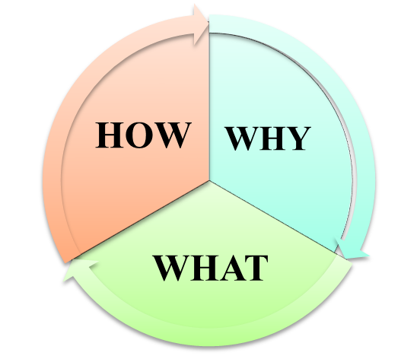
Why Publish a Scientific Paper?
For other researchers to learn about your work.
Scientific publications are the most important indicator of a scientist’s track record.
PLANNIG
Aim and main message of the article?
Article or conference presentation?
What journal?
A research project is unfinished without a publication.

Slide 10
The Improvement Cycle
ACT
Revise
Plan
Plan the work carefully before you start
Do
Make a manuscript
Study
Scrutinize
Check the language
Submit
Discuss the manuscript with the others
What question (problem) is studied? in the Introduction.
How is the problem studied? the Methods.
What are the findings?
• What does these findings means? Discussion.
the Results.

Slide 11
Organization of scientific paper
IMRAD: is usually used.
Introduction
Method
Results ( Text, Tables, and Figures)
Discussion
Some times it is desirable to combine the Materials and Methods and the Results into an integrated “Experimental” section.
It is good to refer to “Instructions to Authors”.
First Scientific Journal appeared in 1665
In 2005 about 15000-20000 Journals exists.

Slide 12
Ideas for Preparing to write
• Highly regarded papers in the research area should be studied.
• Reading papers from the journal you would like to submit your article.
• Instructions of the journal should be followed.
• General instructions can be found in:
– The Chicago Manual of Style 2003
– Publication manual of the American Psychological
Association 2001.
• While reading create files for each section include new ideas.

Slide 13
How to Prepare the Title
• The title will be read by many people while the paper will be read by few.
What is a good title?
It is the fewest words that can describe the
contents of the paper.
Indexing and abstracting depends on the title.
• Titles should not contain:
– Abbreviations
– Chemical formulas
– Proprietary names (ownership names)
– Jargon (slang)

Slide 14
Length of the Title
• Titles should be short but not too short.
• Should be specific.
• Long title is waste of words.
• Words to be avoided:
Studies on, Investigation on, Observation on, A, An or The.
The Title as a Label
• The title of a paper is a label not a sentence.
• The order of words is very important.
• Should be suitable for indexing.
• The title should highlight the significant content of the paper.
• Running title are printed on the top of each page to help the reader.

Slide 15
How to List Authors and Addresses
• There are no agreed rules on the right order of
authors.
• Some prefer to list their names alphabetically.
(in Mathematics this is universal).
• In the past the Head of Lab etc. was used to put his/her name.
Now the first author is the senior author ( the senior author is the person who did the largest part of the research).
Once you decide which journal your paper will be submitted to, then read the instruction for authors in that journal carefully.

Slide 16
ABSTRACT
Abstract should be short but give the overall idea:
what was done?
what was found?
what are the main conclusions?
What is “ABSTRACT”?
The Abstract is a miniature version of the paper.
• An Abstract should provide a brief summary of each main sections of the paper (Introduction, Materials and Methods, Results and Discussion).

Slide 17
Types of Abstracts
• In research papers we use informative abstract.
• In reports, review papers and conference reports we use indicative or descriptive abstract.
• Indicative abstract is more or less like table of
content.
• Abstracts will be published by itself. Thus it should contain no bibliographic, figure, or table reference….
The language should be familiar to the potential
reader. Omit abbreviations and acronyms. Write the paper before you write the abstract.

Slide 18
Introduction
The introduction is one of the most important sections of a scientific article.
It should:
introduce the reader to the problem
give the context of the problem
review previous work
justify the work
give scope and objectives
make the reader interested

Slide 19
Introduction Moves
The four different types of information and ideas found in the introduction are commonly structured in a particular way.
One linguistic researcher, Swales (1984), after surveying a substantial number of published articles across a wide range of disciplines, he has described the way theses types of information and ideas are structured as a pattern of moves.

Slide 20
THE MOVES
MOVE 1 : Introduce the topic and emphasize why is it important!
MOVE 2 : Relate to current knowledge: "What's been done" and "What need's to be done?“
MOVE 3 : Preparing for present research, indicating a gap, raising a question.
MOVE 4 : Introduce your work give the purpose and main objective.

Slide 21
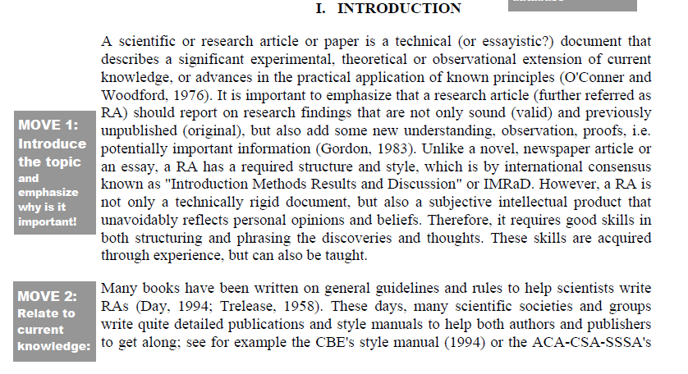
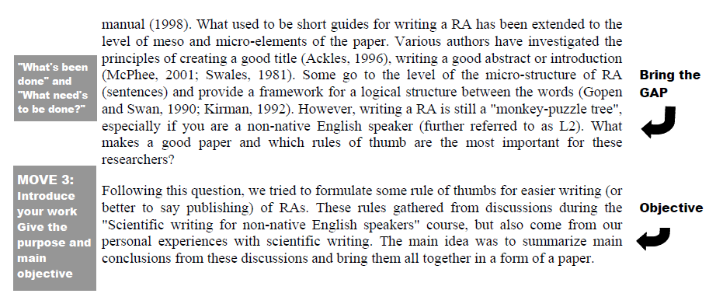
Example

Slide 22
How to Write the Materials and Methods Section
Purpose of this Section:
This part is usually written in the past tense.
In this part full details are to be given about the
technique used.
In case experiments are used they should be
reproducible. The potential of reproducing the
same results must exist.
Include the exact technical specifications and quantities and source or method of preparation.

Slide 23
Materials and Methods
Avoid trade names.
If trade name is to be cited then it should be capitalized to distinguish it from generic name.
Normally generic name immediately follow the trade name (e.g. Kleenex facial tissues).
Description of what was needed to do the work (e.g., specimens), what was done, and how it was done, when and where (if these are necessary details).
Not a narrative, as you might write to your friend describing your day (“First we drove the van to the river, then we launched the boat and. . . .”) but rather a concise description of what a reader would need to envision, understand, assess, and (if needed) replicate the work.

Slide 24
Measurements and Analysis (Results)
• Be precise.
• Questions such as “how much” and “how”
should be precisely answered by the author.
• Statistical analysis are often necessary.
Discuss the data not the statistics.
• Ordinary statistical methods are to be used
without comment; advanced or unusual methods may require literature citation.
Figures (as needed), Tables (as needed).
No interpretation, no comparison, just the facts, with no editorializing.

Slide 25
Individual Words
The Main Principals
1- Write with the reader in mind:
-To obtain good results is very nice.
-Collection of data can not speak for it self. It
needs to be well communicated.
-Your readers are scientists, reviewers, students, researchers…etc.

Slide 26
2- Use Precise words
Bad example:
The current remained increased for several hours.
Nests were observed frequently for signs of predation.
The carbonate layer was prepared with sodium
carbonate.
Revised good sentences:
The current remained increased for 6 hours.
Nests were observed 12 hours for signs of predation.
The carbonate layer was prepared in the presence of sodium carbonate.

Slide 27
3- Use Simple Words
Words should be precise and simple.
Bad example:
Fractions of 0.8 ml were collected, reduced to dryness, and dissolved in 3.4% methanol prior to being sequenced.
Our results reflects deviations from thermal equilibrium during desorption.
Revised good sentences:
Fractions of 0.8 ml were collected, dried, and dissolved in 3.4% methanol prior to being sequenced.
Our results deviate from thermal equilibrium during desorption.

Slide 28
- Many English as a Second Language authors
convert vocabulary of their native language for
use in English writing.
- In some cultures pompous words are extensively used, and statements tend to be indirect.
- Be careful not to overuse pompous words and
phrases. Use direct statements.
- To ensure that your readers understand what
you are writing use simple words.

Slide 29
How to Write the Discussion
• This is the hardest part to write.
• Papers are rejected because of a faulty discussion.
• Many discussions are too long and verbose.

Slide 30
Components of the Discussion
1. Try to present the principles, relationships, and generalizations shown by the results.
2. Point out any exceptions or any lack of correlation and define unsettled points.
3. Show how your results and interpretations agree (or contrast) with previously published work.
4. Begin with the interpretation of the data, with respect to the specific objectives of the study, and ending with the concepts used to start the Introduction.
5. Discuss the theoretical implications of your work, as well as any possible practical applications.
6. Summarize your evidence for each conclusion.

Slide 31
Factual Relationships
• The Methods and the Results should correspond to each other.
• The Introduction and Discussion should function as a pair.

Slide 32
Effective Tables
When to use a Table:
• Do not construct a table unless repetitive data
must be presented.
• Present the data in the text, or in a figure or in
a table but do not mix.
• Simple data does not require a table.
• Try to avoid exponents in table headings like
“ cpmX103”.

Slide 33
Effective Graphs
• Graphs are pictorial tables.
• Giving a figure does not add importance to the
work.
• In case words can describe the data, then it is
better to use words.
• Remember that the graph will be reduced so
choice proper size of the symbols.
• Do not put too many information on the graph.
• Use graph instead of a table if it is more
representative.

Slide 34
How to State the Acknowledgments
Ingredients of the Acknowledgments:
• The paper is usually followed by Acknowledgment and References.
• Two main things are required in the Acknowledgement:
– Any significant help received from an individual.
Source of special equipment, and other materials are to be acknowledged.
- Any outside financial assistance such as grants, scholarship, or contract

Slide 35
How to Cite a Reference
Rules to Follow: there are two rules:
1- Cite the significant published references.
2- References to unpublished data, abstracts, theses, and other secondary materials should not clutter up the References. A paper that been accepted for publication can be cited followed by “in press” or “forthcoming”.
3- Check all parts of every reference against the original publication before the manuscript is submitted and perhaps again at the proof stage.

Slide 36
References Styles
• Journals has various styles of handling references.
• It is better that you write full information about the references you used because you might submit the paper to another journal or use the references in future work.
• Follow the instructions otherwise it might be considered as a sign of previous rejection or evidence of lack of care.
• Although there are different reference styles.
Three main styles are very common:
–Name and year
–Alphabet-number
–Citation order

Slide 37
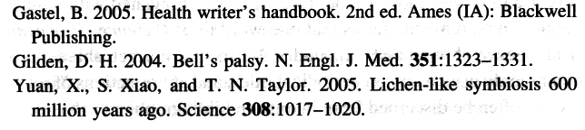
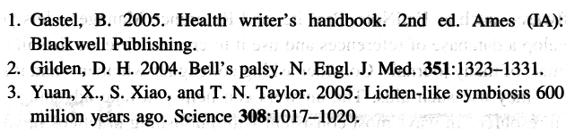
Name and Year System:
Alphabet-Number System:

Slide 38
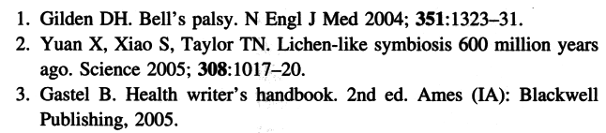
Citation Order System:

Slide 39
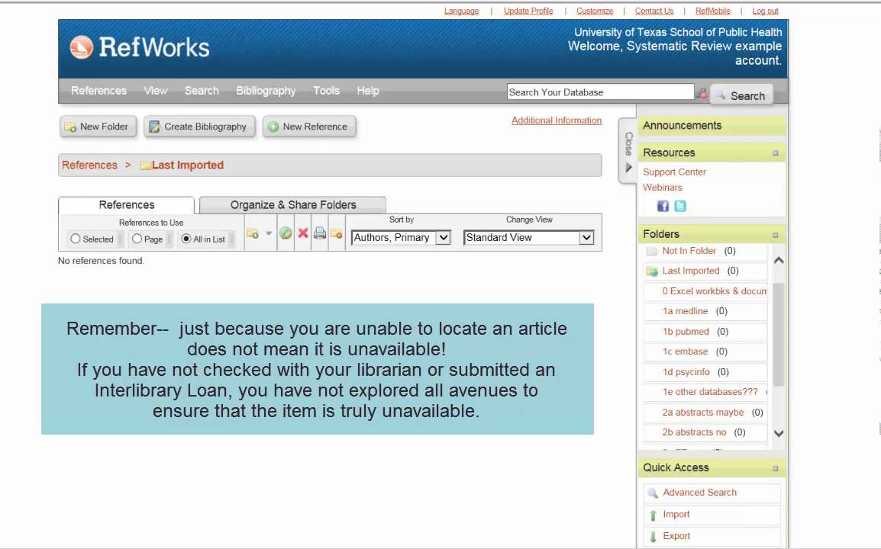


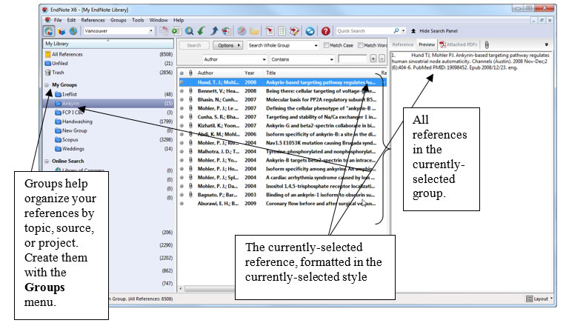
Software use to Arrange References

Slide 40
Revising your Work
Good writing tends to be largely a matter of good revising.
Revision is not for students only.
Show the work to others and get feedback and revise your work some more.

Slide 41
In revising your work ask yourself the following questions
Does the manuscript include all the information it should? Does it contain anything it shouldn’t?
Is all the information accurate?
Is what you say consistent throughout?
Is everything logically organized?
Is everything clearly worded?
Have you stated your points briefly, simply, and directly?
Are grammar, spelling, punctuation, and word use correctly?
Are all figures and tables well designed?
Dose the manuscript comply with the instructions?

Slide 42
Where to Publish
• What is the scope of the paper?
• Who do you want to read your paper? (if the answer is many you could consider publication in different journals with a twitch)
• Once chosen, publish in as high impact journal as possible

Slide 43
How to Publish
Golden rule: Write for the reader
• Template often provided by the journal
• Build ”your case” around figures, plots, graphs and/or equations.
• Any of the above introduced should be discussed in detail. No dead figures!
• Be clear and structured.

Slide 44
Where to Submit Your Manuscript
• Why Decide Early, Why Decided Well
• It should be early decided at what journal should we publish our paper in so that we follow the journal requirements.
• Choosing the right journal you can reach the most suitable audience.
• In case you pick the wrong journal then:
– The manuscripts may simply be returned to you.
– Your manuscript might receive poor or unfair review.
– Even if the paper is accepted, small number of people will see it.

Slide 45
Prestige, Access, and Impact
• A paper published in “garbage” journal does not equal a paper published in prestigious journal.
• Search for papers published in your field.
• In case you picked three journals A,B and C and A is a new journal published by a commercial company. B is an old, well known small journal published by a famous hospital or museum and C is a large journal published by a society. Then C is the first choice followed by B and then A.
• New journals not sponsored by a society might fail before it will be known to scientific world.
• Electronic journals should be avoided if they are not
prestigious.

Slide 46
• Use the “impact factor” to choice the journal.
In a given year, the impact factor of a journal is the average number of citations to those papers that were published during the two preceding years.

Slide 47
For example, the 2010 impact factor of a journal would be calculated as follow:
A= the number of times articles published in 2008 and 2009 were cited by index journals during 2010.
B= the total number of citable items published in 2008 and 2009. (citable items are usually articles, reviews, proceedings, or notes; not editorials or letters to the editor.).
2010 impact factor = A/B
(note that the 2010 impact factor are actually published in 2011;they can not be calculated until all of the 2010 publications had been received by the indexing agency.)

Slide 48
Immediacy index
Immediacy index is calculated based on the papers published in a journal in a single calendar year.
For example, the 2011 immediacy index for a journal would be calculated as follow:
A= the number of times articles published in 2011 were cited in indexed journals during 2011.
B= the number of articles, reviews, proceedings or notes published in 2011.
2011 immediacy index = A/B

Slide 49
Other Factors to consider
• Speed of publication. Monthly are fastest. 4-7 months. Quarterly up to 10 months.
• In case you have photographs you must look for a high quality reproduction standard journal.
• Aim for broadest and most prestigious journal. where your paper has realistic chance of publication.

Slide 50
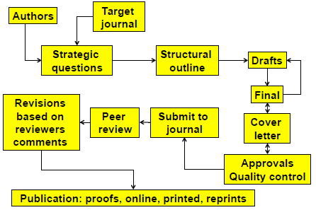
The process of publishing a scientific paper

Slide 51


Slide 52
Conference report
Is a paper in a book or journal as part of the proceedings of a symposium, national or international congress, workshop, roundtable, or the like.
Such conferences do not qualify as primary
publications.
Conference presentations often are review papers,
presenting reviews of recent work of particular
scientists.
In recent conferences new, original data are presented, often accompanied by interesting speculation. Such work can be published later.

Slide 53
Ethics in Scientific Publishing
• Authenticity and Accuracy
The research should be actually done.
Statistical data should be done properly if they exist.
The figures must include all data.
• Originality
The findings must be new.
Manuscripts should be sent to one journal only.
Slicing the findings into several papers should be avoided.
• Credit
Scientists build on other’s work.
Ideas or work of others should be cited otherwise you will be guilty of plagiarism (piracy, larceny).
Every one who qualifies for authorship in the paper should be written.

Slide 54
• Ethical Treatment for Humans and Animals
In case the research involves humans or animals,
documentation that they were treated ethically are required from you by the journals.
• Disclosure of Conflicts of Interest
Authors of papers might have conflict of interest in some cases. Like they own stocks in the company they are doing research on its products or they act as consultants to these
companies.

