Slide 1
Lect 1 Fundamentals of Digital Signal Processing

Slide 2
1.1 The scope of digital signal processing (DSP)
1.1 DSP techniques are now used to analyze and process signals and data
1.2 DSP is concerned with the numerical manipulation (treatment) of signals and data
1.3 The general purpose computer can be used for illustrating DSP theory and application.
1.4 Discrete time signals may be divided into two categories:-
a. Sampled data signals
b. Digital signals

Slide 3
Fig (1.1) shows two discrete time signals

Slide 4
Fig (1.2) shows a typical DSP block diagram
1.2. Some useful applications

Slide 5
Fig (1.3.a) shows a signal sampled at a rate which is clearly too low to pick out the more rapid fluctuations.

Slide 6
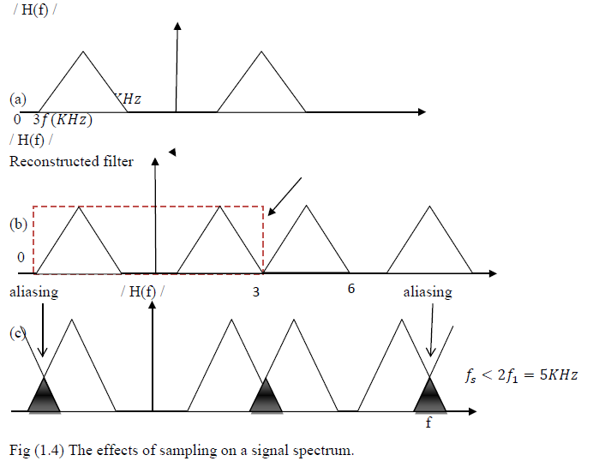
3.4 Fig (1.4a) represents the frequency distribution or spectrum of an analog speech signal. There are no components above maximum frequency.

Slide 7
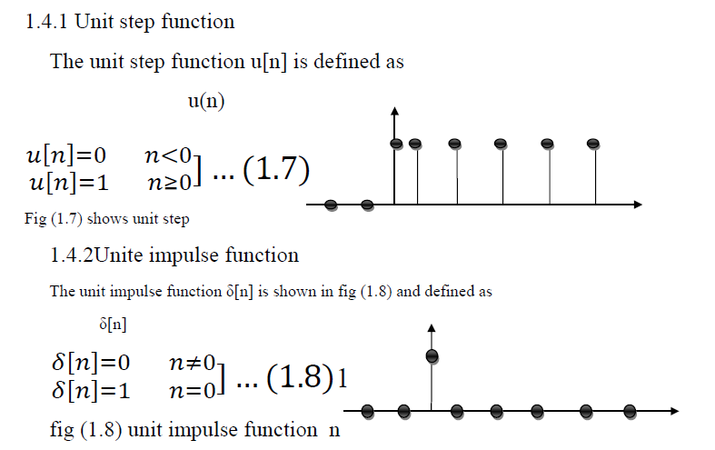
1.4. Basic type of digital signal

Slide 8
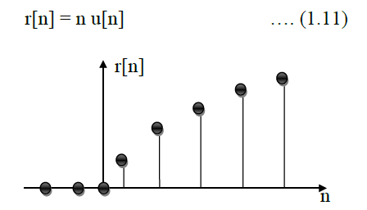
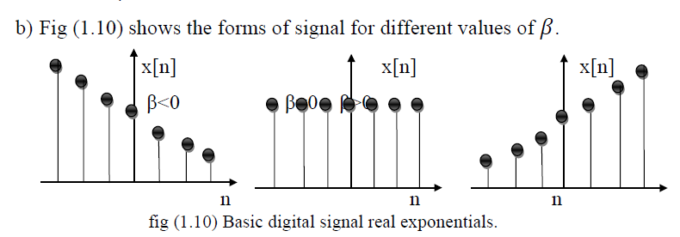
1.4.3 Unit ramp function
1.4.4 Exponential, sine and cosines signal

Slide 9
1.5. Digital Processors
1.5.1 Processor means any system which carriers out a DSP function. It may be a general purpose computer, microprocessor, special hardware or a combination of these. In general the processor is a computer plus software.
1.5.2 No particular distinction between the terms processor and system.

Slide 10
1.6. Linear Time Invariant (LTI) System Properties
1.6.1 A linear system or processor may be defined as one which obeys the principle of superposition.
1.6.2 Furthermore, if an input 𝑎1𝑥[𝑛]produced output ay[n] where a is constant coefficient or multiplier or a weighting factor.
1.6.3 Frequency Preservation: - It means that if we apply an input signal containing certain frequencies to a linear system, the output can contain only the same frequencies and no others.

Slide 11
1.7. Other System Properties [Causality, Stability Invertibility and Memory]
1.7.1 Causality: In a causal system, the output signal depends only on present and/or previous values of the inputs.
1.7.2 Stability: A stable system is one which produces a finite or bounded output in response to a bounded input.
1.7.3 Invertibility: If a digital processor with input x[n] gives an output y[n], then its inverse would produce x[n], if fed with y[n].
1.7.4 Memory: A processor possesses memory if its present output y[n] depends upon one or more previous input values x[n-1], x[n-2],

Slide 12
1.8. Classification of Signals
1.8.1 Deterministic and Random Signal
1.8.2. Periodic and Nonperiodic Signal
1.8.3 Analog and Discrete signals
1.8.4 Analog and Digital Signals

