Slide 1
Lect6 Finite Impulse response (FIR) filter design

Slide 2
6.1 Summary of key characteristic features of FIR filter
Filter design starts from specifications and includes the coefficient calculation, analysis of finite wordlength effects and implementation.
a) The basic FIR filter is characterized by the following two equations

Slide 3
6.2 Linear phase response and its implication
a) The phase delay of the filter is the amount of time delay for each frequency components (𝑇𝑃).
b) The group delay is the average time delay of the composite signal suffer at each frequency 𝑇𝑔
A filter is said to have a linear phase response if its phase response satisfied one of the following relationship:
$∅\left(w\right)=−∝w$ … (6.3a)
$∅\left(w\right)=β−∝w$ … (6.3b)
Where $β and∝$ are constant.

Slide 4
6.3 FIR filter design
As discussed before, the design of a digital filter involve:-
1. Filter specification
2. Coefficient calculation
3. Realization
4. Analysis of finite worldlength effects
5. Implementation

Slide 5
6.4 FIR coefficient calculation methods
a) Window method
b) Optimal method
c) Frequency sampling method

Slide 6
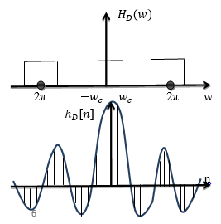
6.4.1 Window Method
The frequency response of a filter,$H_{D}(w)$ and the corresponding impulse response,$h_{D}[n]$ are related by the inverse FT.
$h_{D}\left[n\right]=\frac{1}{2π}\int_{−π}^{π}{H_{D}(w)}e^{jwn}dw$ …. (6.8)
The subscript D is used to distinguish between the ideal and practical impulse response.Let us consider to design a low pass filter with cutoff frequency $w_{c}$as shown in fig (6.2).
$h_{D}\left[n\right]=\frac{1}{2π}\int_{−w_{c}}^{w_{c}}{x}e^{jwn}dw=\frac{1}{2π}\int_{−w_{c}}^{w_{c}}{e^{jwn}}dw$
$$=\frac{1}{2π}\frac{1}{jn}\left[e^{jw_{c}n}−e^{−jw_{c}n}\right]=\frac{2}{2π}\frac{e^{jw_{c}n}−e^{−jw_{c}n}}{2jn}=\frac{w_{c}}{π}\frac{e^{jw_{c}n}−e^{−jw_{c}n}}{2jw_{c}n}$$
$=2f_{c}\frac{sinw_{c}n}{w_{c}n}$ for $−∞<n<∞$ … (6.9)
$=2f_{c}$ for n=0 using Hopital transform

Slide 7
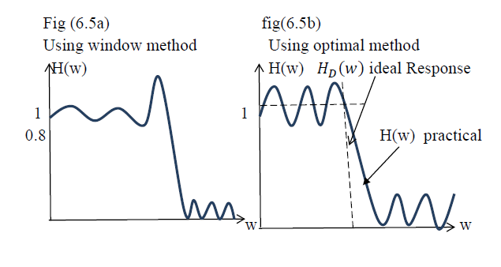
6.4.2 The optimal method
The optimal method of calculating FIR filter coefficients is very powerful, very flexible, because of the existence of an excellent design program.

Slide 8
6.4.3 Frequency Sampling method
The frequency sampling method allows us to design nonrecursive FIR filters for both standard frequency selective filters (low pass, high pass, band pass filters) and filters with arbitrary frequency response. A main attraction of the frequency sampling method is that it also allows recursive implementation of FIR filters.

