Slide 1
Influences of machining parameters on metal removal rate MRR and accuracy in electrochemical machining
Prepared by
Msc. Student
Baqer Ayad Ahmed
Supervised by
Asst. Prof. Dr.Saad Kariem Shather

Slide 2
INTRODUCTION
Electrochemical Machining (ECM) is a non-traditional machining (NTM) process belonging to electrochemical category. ECM is opposite of electrochemical or galvanic coating or deposition process. Thus ECM can be thought of a controlled anodic dissolution at atomic level of the work piece that is electrically conductive by a shaped tool due to flow of high current at relatively low potential difference through an electrolyte which is quite often water based neutral salt solution.

Slide 3
The new concept of manufacturing uses non conventional energy sources like sound, light ,mechanical, chemical, electrical, electrons and ions. With the industrial and technological growth, development of harder and difficult to machine materials, which find wide application in aerospace, nuclear engineering and other industries owing to their high strength to weight ratio, hardness and heat resistance qualities has been witnessed. The problems of high complexity in shape, size and higher demand for product accuracy and surface finish can be solved through non-traditional methods. Currently, non-traditional processes possess virtually unlimited capabilities except for volumetric material removal rates, for which great advances have been made in the past few years to increase the material removal rates.

Slide 4
Electrochemical Machining (ECM) is the controlled removal of metal by anodic dissolution in an electrolytic cell in which the work piece is the anode and the tool is cathode. The electrolyte is pumped through the gap between the tool and the work piece, while direct current is passed through the cell, to dissolve metal from the work piece. ECM is widely used in machining of jobs involving intricate shapes and to machine very hard or tough materials those are difficult or impossible to machine by conventional machining. It is now routinely used for the machining of aerospace components, critical deburring, Fuel injection system components, ordnance components etc. ECM is also most suitable for manufacturing various types of dies and moulds.

Slide 5
The aim of this work is :
1- The influence of electrolyte concentration on MRR
2- Influence of rotating tool on MRR and Surface roughness
3-Estimation of error during ECM

Slide 6
LITERATURE REVIEW:
S. Kumara et.al[2004] :discussed about the Material removal rate (MRR) of aluminum work piece has been obtained by electrochemical machining using NaCl electrolyte at different current densities. Also resistance of the electrolyte solution decrease sharply with increasing current densities. The over-voltage of the system initially increases and then attains a saturation value with increasing current densities.

Slide 7
C. Senthilkumar & G. Ganesan & R. Karthikeyan [2009] :
investigate the influence of some predominant electrochemical process parameters such as applied voltage, electrolyte flow rate and tool feed rate on the metal removal rate (MRR), and surface roughness (Ra) to fulfill the effective utilization of electrochemical machining of LM25 Al/10%SiC composites

Slide 8
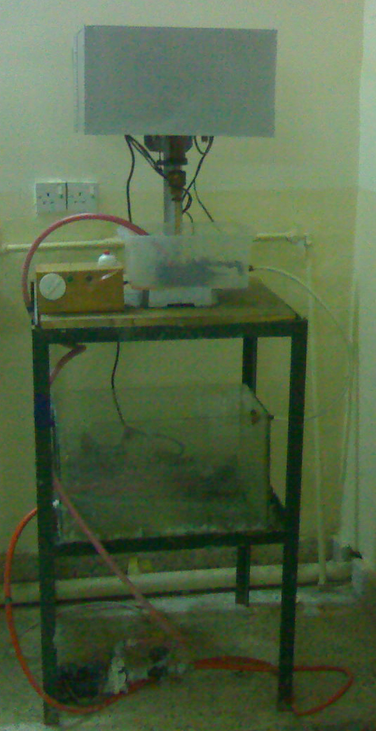
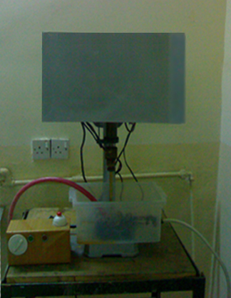
EXPERIMENTAL ARRANGEMENT
ECM machine

Slide 9
Our study will be on aluminum alloy workpiece
(AL Zn Mg Cu 1.5-DIN 1725-1)
Si% | Fe% | Cu% | Mn% | Mg% | Cr% | Ni% | Zn% | AL%
0.059 | 0.206 | 1.84 | 0.206 | 2.17 | 0.190 | 0.001 | 5.57 | remain

Slide 10
1- Effect of electrolyte concentration on MRR & surface roughness(Ra)

