Slide 1
Optimization Factors Influencing on Cathodic Protection For Steel Wall
By
SAAD E. KASKAH
Supervised by
Asst. Prof. Dr. Mohammad H. Hafiz
&
Lecturer Dr. Wisam K. Hamdan

Slide 2
Aim of the research
This work aim to obtain the optimize factor influence on cathodic protection for steel wall by control the potential differences which required to build a cathodic protection system in difference environment parameters by studying different anodes alloy at different distance between anode and cathode with ranges of areas for steel wall.
Consideration experimental work by building a sacrificial cathodic protection system as shown in Fig.(1) in next slide.

Slide 3
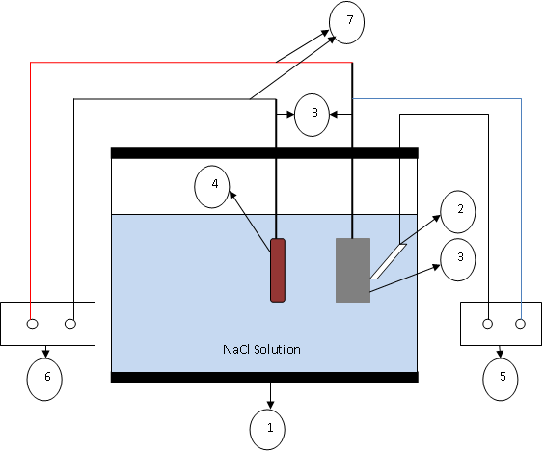
Sketch of Sacrificial Cathodic Protection System

Slide 4
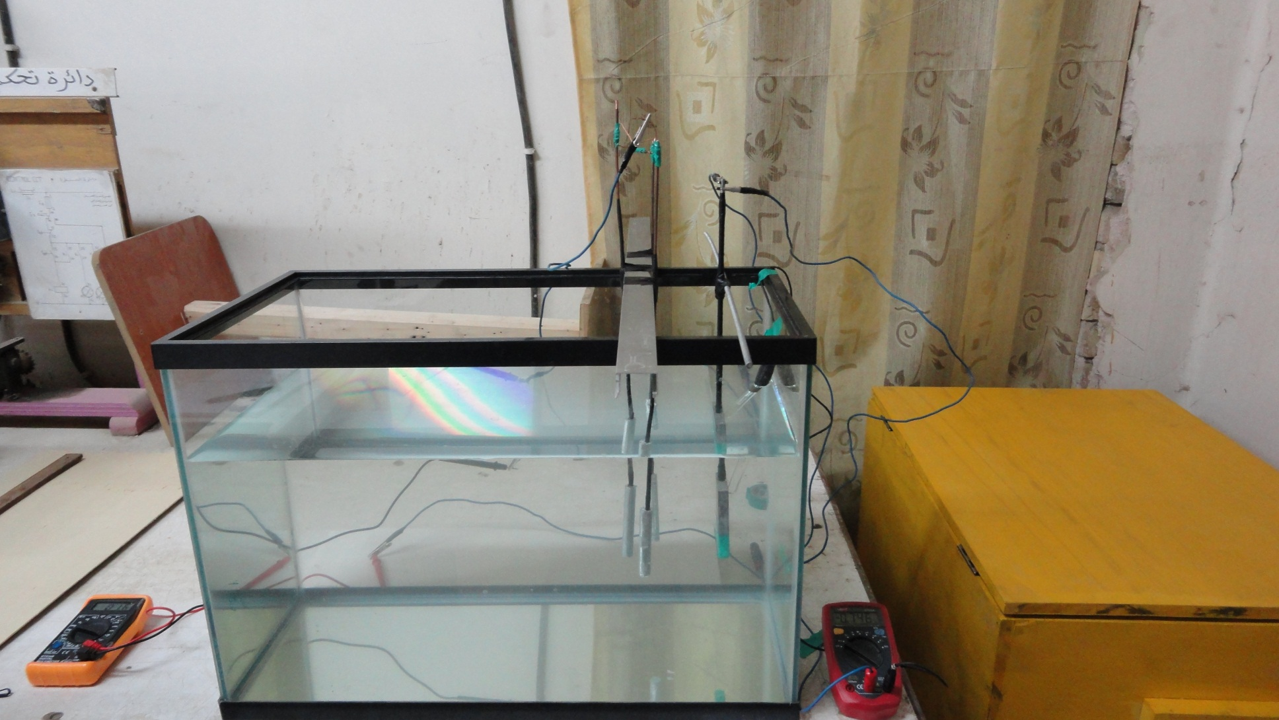
Experimental Work System Picture

Slide 5
Scope of the work
Search and find the references for the subject
Search what the recent work that made on cathodic protection
Building sacrificial cathodic protection system
Prepared the mainly specimens for the work
Make analyzing and inspections for the specimens
Make the running for experimental work
Now the process in the prepare the optimization.

Slide 6
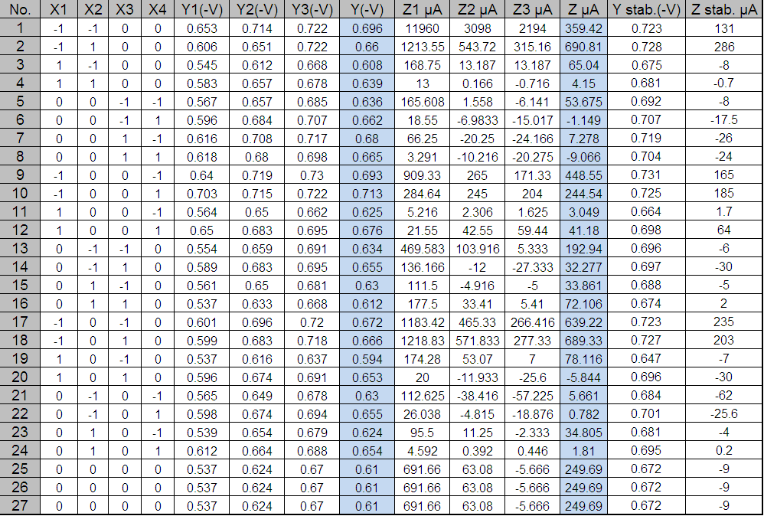
Data result that will be use in optimization

