Slide 1
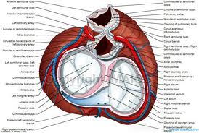
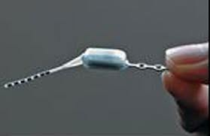
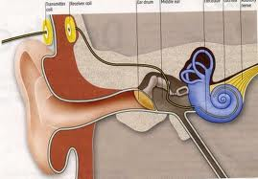
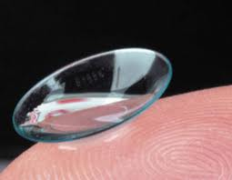
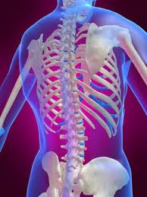
Synthesis, Structure and Corrosion Behavior of Nanocoatings for Surgical Implants Materials
وزارة التعليم العالي والبحث العلمي
الجامعة التكنولوجية
قسم هندسة الانتاج والمعادن
تقرير عن البعثة البحثية في جامعة ميزوري –كولومبيا
الولايات المتحدة الامريكيا
by
Haitham M. W.
(Ph.D. student / Metallurgy Eng.)
Supervised by;
Prof. Dr. Muna K. Abbass
Assist. Prof. Dr. Sami Abualnoun Ajeel

Slide 2
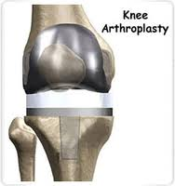
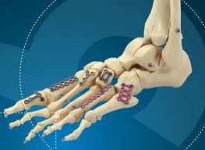
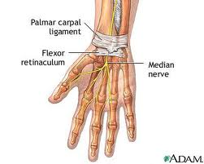
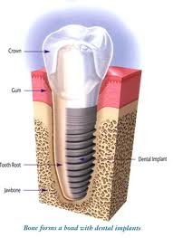
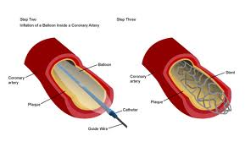
المقدمة:
مراحل العمل في ميزوري :
اولا : التدريب على الاجهزة المختبرية .
ثانيا : العمل البحث .
ثالثا :جمع النتائج ومطابقتها وتوثيقها .
الهدف من البعثة البحثية:
Synthesis nano coatings thin films for surgical implants alloys by advance nanocoatings methods.
Characterization and Evaluations the nano coatings thin films by using Ellipsometry and Raman spectroscopy, TEM, AFM, and other techniques.

Slide 3
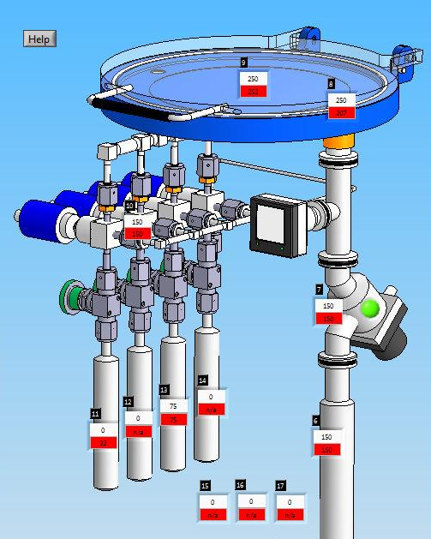
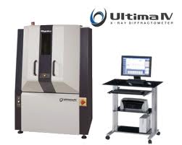
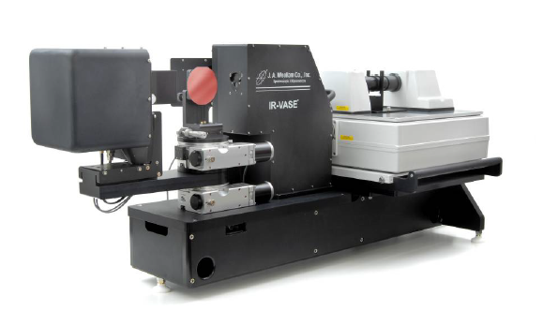
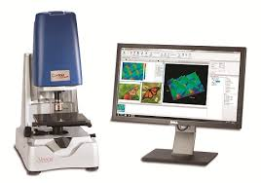
Atomic Layer Deposition
Raman Spectroscopy
X-Ray Diffraction
Optical Profilometer
Ellipsometry Spectroscopy
First;

Slide 4
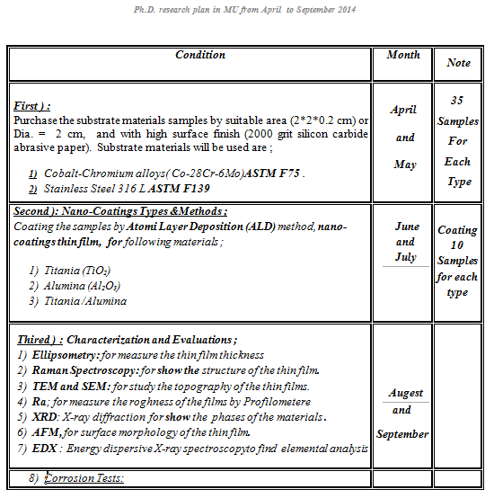
Second: Details of Work

Slide 5
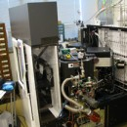
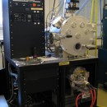
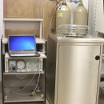
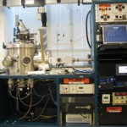
MU Nanocoatings Methods
Plasma enhanced chemical
vapor deposition
Electron Beam evaporations
Sputtering systems
(ion-beam sputtering,&
magnetron sputtering).
Atomic Layer Deposition
(ALD)

Slide 6
Atomic Layer Deposition (ALD)
Introduction :
A method of applying thin films to various substrates with atomic scale precision.
Introduced in 1974 by Dr. Tuomo Suntola and co-workers in Finland to improve the quality of ZnS films used in electroluminescent displays
Is a thin film Deposition method by which precursor gases or vapors are alternately pulsed on to the substrate surface .
Precursor gases introduced on to the substrate surface will chemisorb or surface reaction takes place at the surface .
Surface reactions on ALD are complementarity and self-limiting .

Slide 7
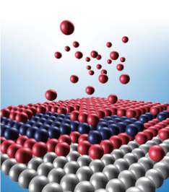
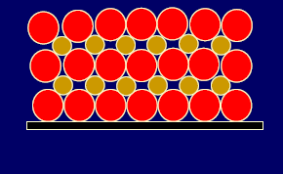
Advantge :
Excellent thin films thickness controll (by counting the number of reaction cycles
Uniform thickness over large areas and inside narrow holes (3D)
Atomic level of control over film composition ⇒ nano laminates and multi- component materials
Very smooth surfaces (for amorphous films)
High density film and no pinholes
Self-limited process and Easy to scale up .
Low deposition temperatures (for very reactive precursors)

Slide 8
Applications
Biomedical coatings(Biocompatible ) : (TiN, ZrN, CrN, TiAlN, AlTiN)
Wear and corrosion inhibiting layers (TiO_{2 ,} Al₂O₃, ZrO₂)
Anti-reflection and optical filters (Al₂O₃, ZnS, SnO₂, Ta₂O₅ )
ALD metals (Ru, Pd, Ir, Pt, Rh, Co, Cu, Fe, Ni)
Nanostructures (all materials)Conformal deposition around and inside nanostructures and MEMS
Oxides (Al₂O₃, ZnO, TiO₂, HfO₂ , HfSiO, La₂O₃, SiO₂, Ta₂O₅) ,

Slide 9
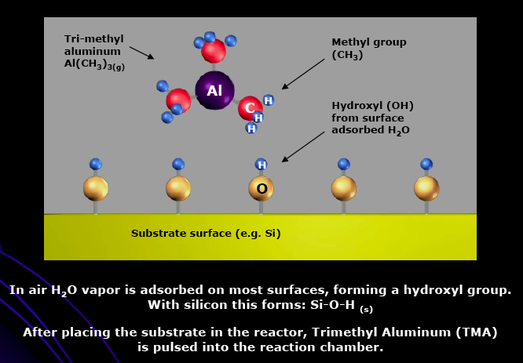
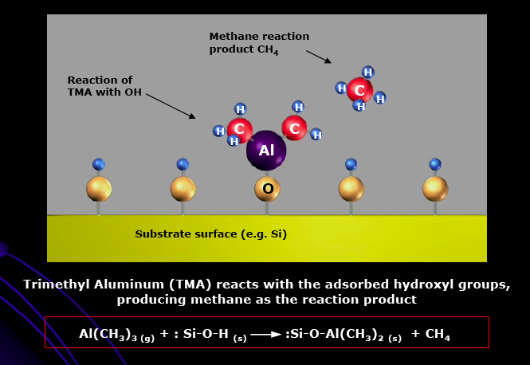
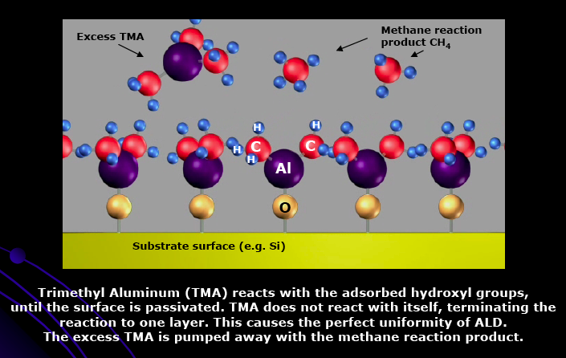
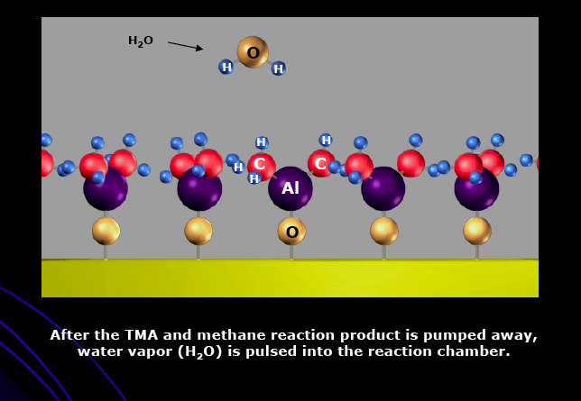

Slide 10
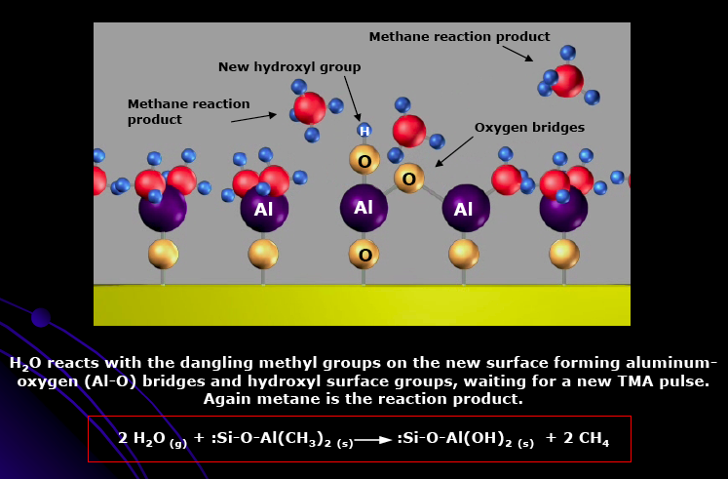
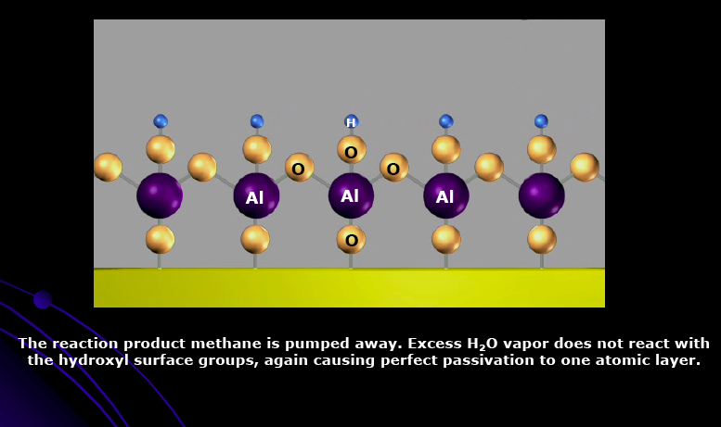
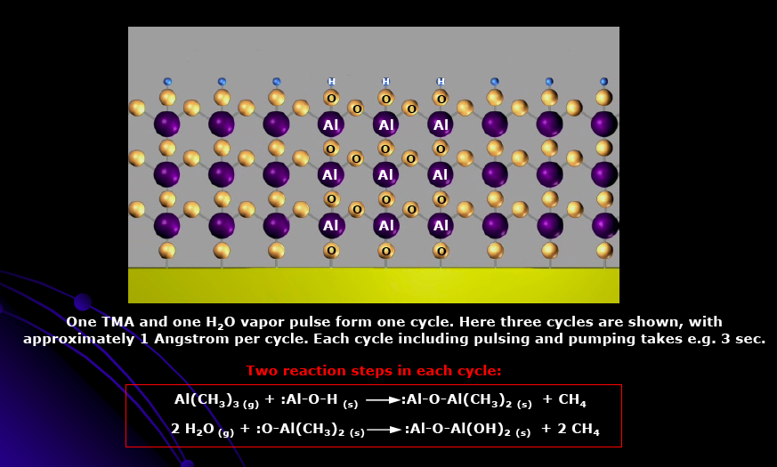

Slide 11
TDMAT
or TMA Pulse
TDMAT
or TMA Pulse
H₂O
Pulse
H₂O
Pulse
On
1
3
1
3
N₂
Purge
N₂
Purge
N₂
Purge
N₂
Purge
Off
2 4 2 4
Time (sec)
Figure ( 3-4 ) : Atomic Layer Deposition cycle.

Slide 12
April
Table (1): Data results by ellipsometer for Titania thin film deposited by ALD.
Type | 25 nm Titania | 50nm Titania | Note
No of cycles (X) | 642 | 1284 | Growth per Cycle= ~0.39Å
Theoretically Thickness (Y) | 25 nm | 50 nm
Measured Thickness | 23.9 nm | 43.04 nm
Standard deviation | 0.55% | 3.5%
Refractive index(n) | 1.931 | 2.145
May
Table (2): Data results by ellipsometer for Alumina thin film deposited by ALD.
Type | 25 nm Alumina | 50 nm Alumina | Note
No of cycles (X) | 250 | 480 | Film growth per Cycle = ~1.07Å
Theoretically Thickness (Y) | 25 nm | 50 nm
Measured Thickness | 26.99 nm | 47nm
Standard deviation | - 0.99% | 1.5%
Refractive index (n) | 1.618 | 1.638

Slide 13
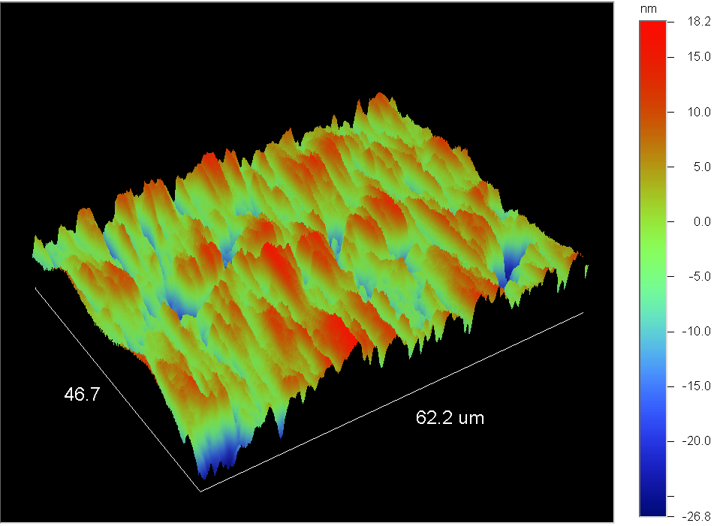
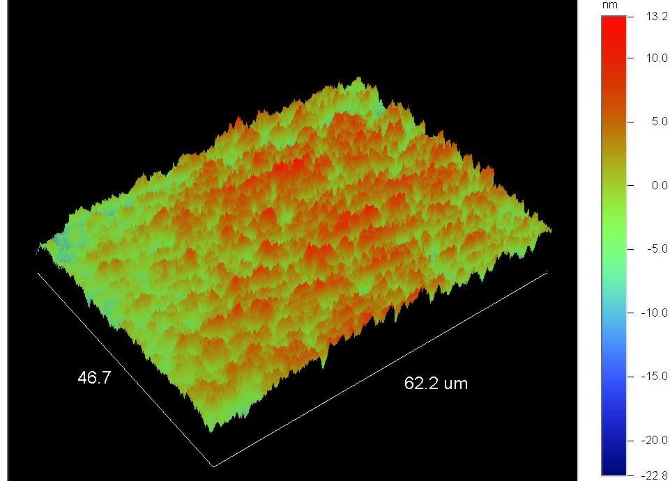
a)
b)
Figure (3): Roughness results for thin films deposited on Co-Cr-Mo alloy by optical Profilometer at;
a) 25nm Alumina
d) 25 nm Titania

Slide 14
Figure (4): Lifting sample free I-beam by Omniprobe for the 50nm Titania film at ;
30 µ magnification.
5 µ magnification .

Slide 15
5 nm
21 nm
Figure (5): High-resolution transmission electron microscopy micrograph (HRTEM) for 50 nm Titania thin film after lift-out.
Figure (6): Selected area diffraction pattern( SADP) for 50 nm Titania thin film after lift-out.

Slide 16
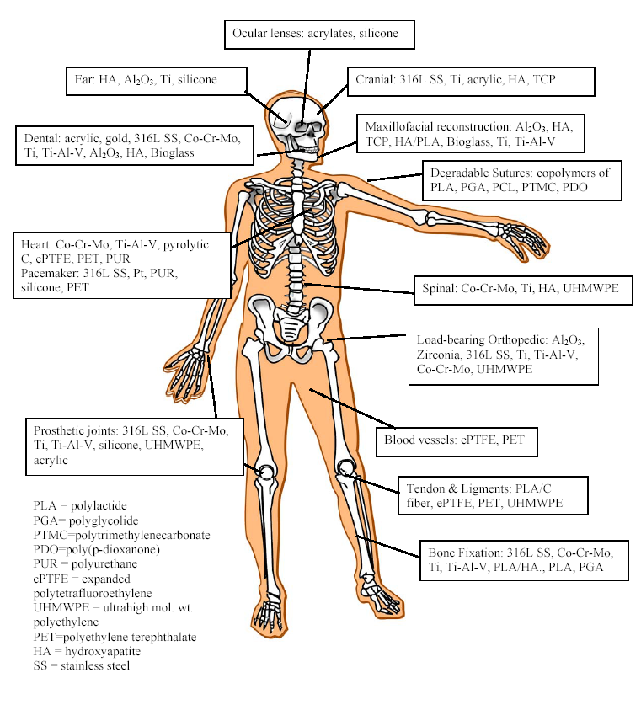
Thank you for listening
I appreciate it

