Slide 1
Chapter Seven
Compressible Fluid

Slide 2
Introduction
When a fluid moves at speeds comparable to its speed of sound, density changes become
significant and the flow is termed compressible. Such flows are difficult to obtain in liquids, since high pressures of order 1000 atm are needed to generate sonic velocities.
In gases, however, a pressure ratio of only 2:1 will likely cause sonic flow. Thus compressible gas flow is quite common, and this subject is often called gas dynamics
However, in some cases, gases can be consider as incompressible if the cahne in density <10%

Slide 3
Introduction
Probably the two most important and distinctive effects of compressibility on flow are
(1) choking, wherein the duct flow rate is sharply limited by the sonic condition,
(2) shock waves, which are nearly discontinuous property changes in a supersonic flow.
Five changeable quantities are important in compressible flow
1- Cross sectional area
2- Density
3- Temperature
4- Velocity
5- Pressure

Slide 4
Object
Describe how compressible flow differs from incompressible flow
Describe a criteria how compressible flow can be treated as incompressible flow
Write basic equations of compressible flow
Describe a shape in which a cobmpressible fluid can be accelerated to a velocity above speed of sound

Slide 5
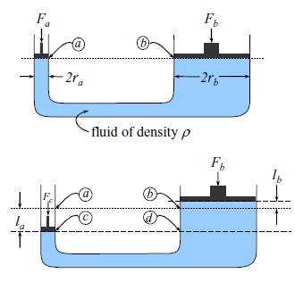
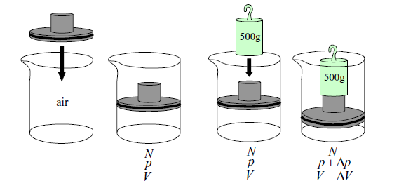
Compressible and incompressible fluid
Static incompressible fluid static compressible fluid

Slide 6
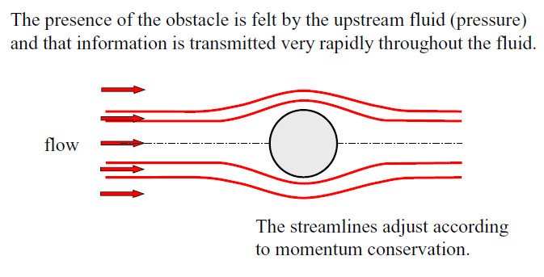
Moving incompressible fluid

Slide 7
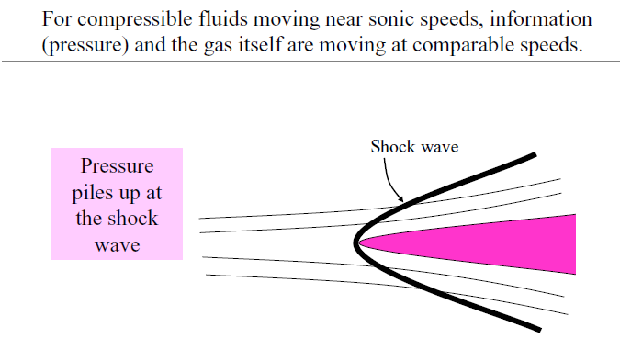

Slide 8
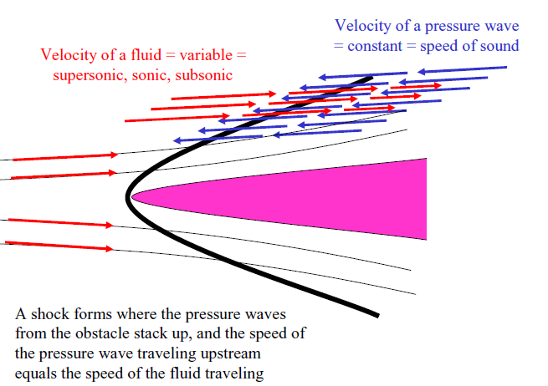
downstream

Slide 9
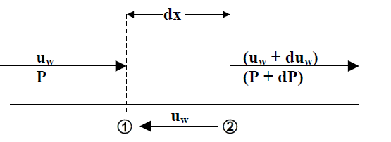
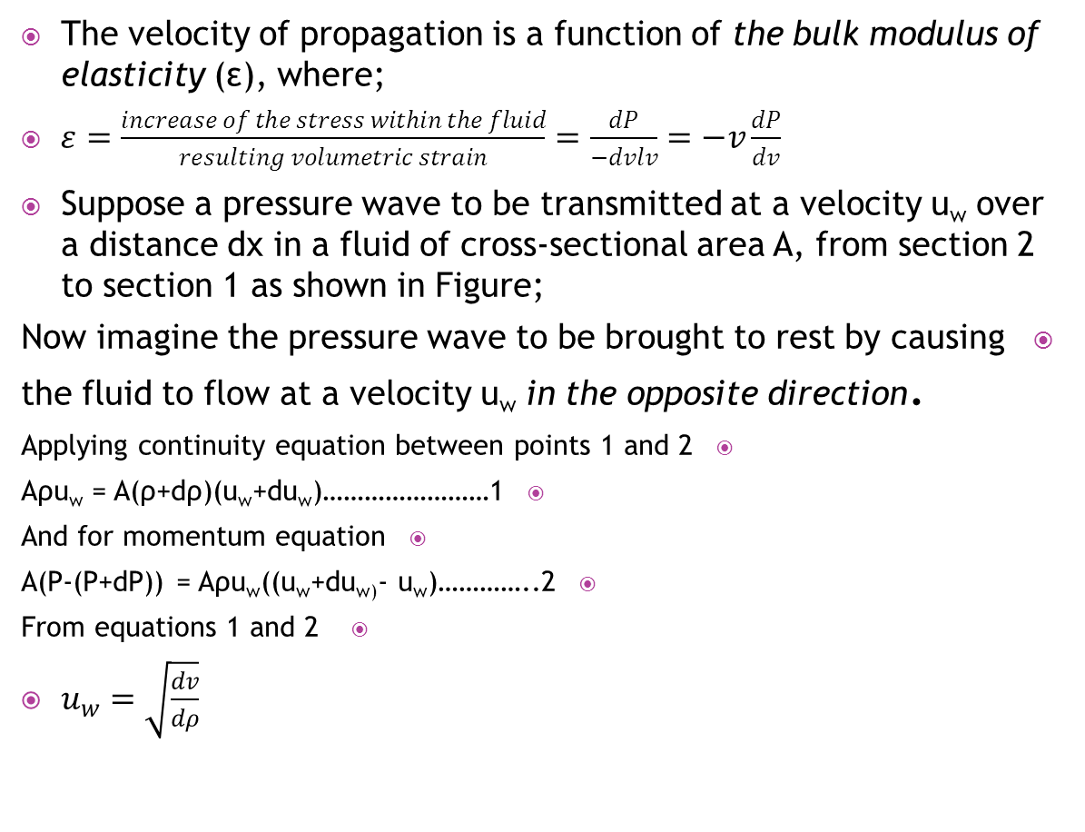
Velocity of Propagation of a Pressure Wave
The velocity of propagation is a function of the bulk modulus of elasticity (ε), where;
$ε=\frac{increase of the stress within the fluid}{resulting volumetric strain}=\frac{dP}{−dvlv}=−v\frac{dP}{dv}$
Suppose a pressure wave to be transmitted at a velocity u_{w} over a distance dx in a fluid of cross-sectional area A, from section 2 to section 1 as shown in Figure;
Now imagine the pressure wave to be brought to rest by causing the fluid to flow at a velocity u_{w}in the opposite direction.
Applying continuity equation between points 1 and 2
Aρu_{w}= A(ρ+dρ)(u_{w}+du_{w})……………………1
And for momentum equation
A(P-(P+dP)) = Aρu_{w}((u_{w}+du_{w)}- u_{w})…………..2
From equations 1 and 2
$u_{w}=\sqrt{\frac{dv}{dρ}}$

Slide 10
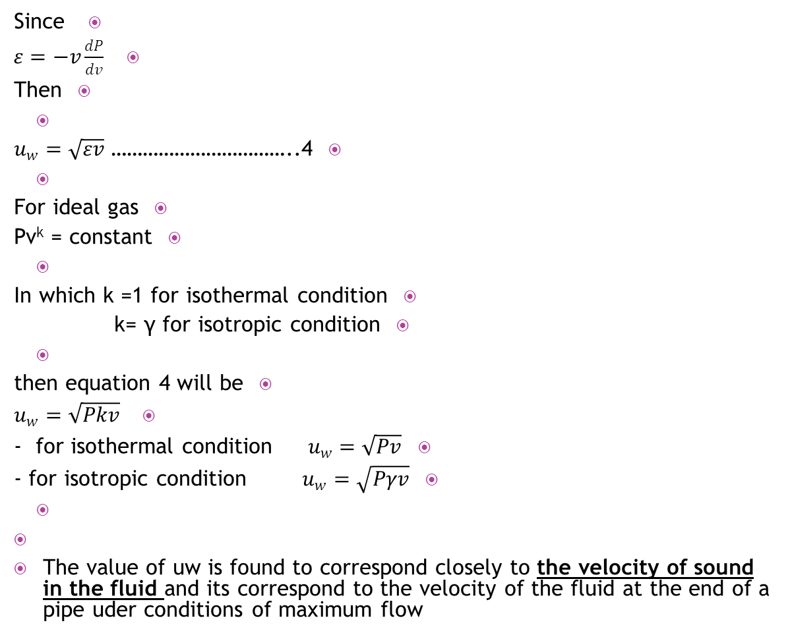
Since
$ε=−v\frac{dP}{dv}$
Then
$u_{w}=\sqrt{εv}$ ……………………………..4
For ideal gas
Pv^{k} = constant
In which k =1 for isothermal condition
k= γ for isotropic condition
then equation 4 will be
$u_{w}=\sqrt{Pkv}$
- for isothermal condition $u_{w}=\sqrt{Pv}$
- for isotropic condition $u_{w}=\sqrt{Pγv}$
The value of uw is found to correspond closely to the velocity of sound in the fluid and its correspond to the velocity of the fluid at the end of a pipe uder conditions of maximum flow

Slide 11
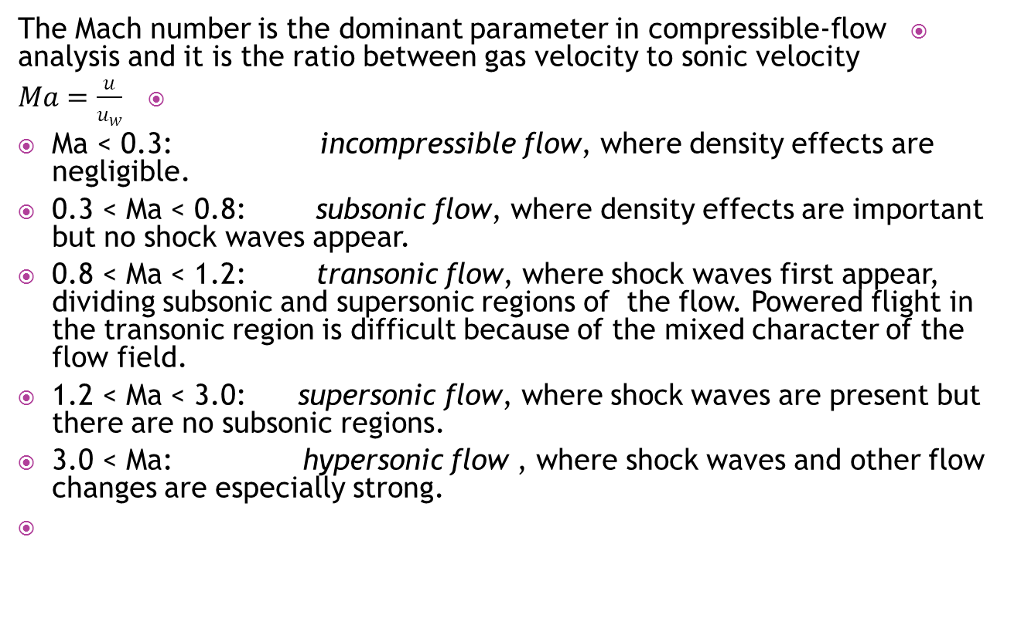
Mach number
The Mach number is the dominant parameter in compressible-flow analysis and it is the ratio between gas velocity to sonic velocity
$Ma=\frac{u}{u_{w}}$
Ma < 0.3: incompressible flow, where density effects are negligible.
0.3 < Ma < 0.8: subsonic flow, where density effects are important but no shock waves appear.
0.8 < Ma < 1.2: transonic flow, where shock waves first appear, dividing subsonic and supersonic regions of the flow. Powered flight in the transonic region is difficult because of the mixed character of the flow field.
1.2 < Ma < 3.0: supersonic flow, where shock waves are present but there are no subsonic regions.
3.0 < Ma: hypersonic flow , where shock waves and other flow changes are especially strong.

Slide 12
Basic equation in compressible flow
1. Continuity equation
2. Momentum equation
3. Energy equation
4. Equation of state

Slide 13
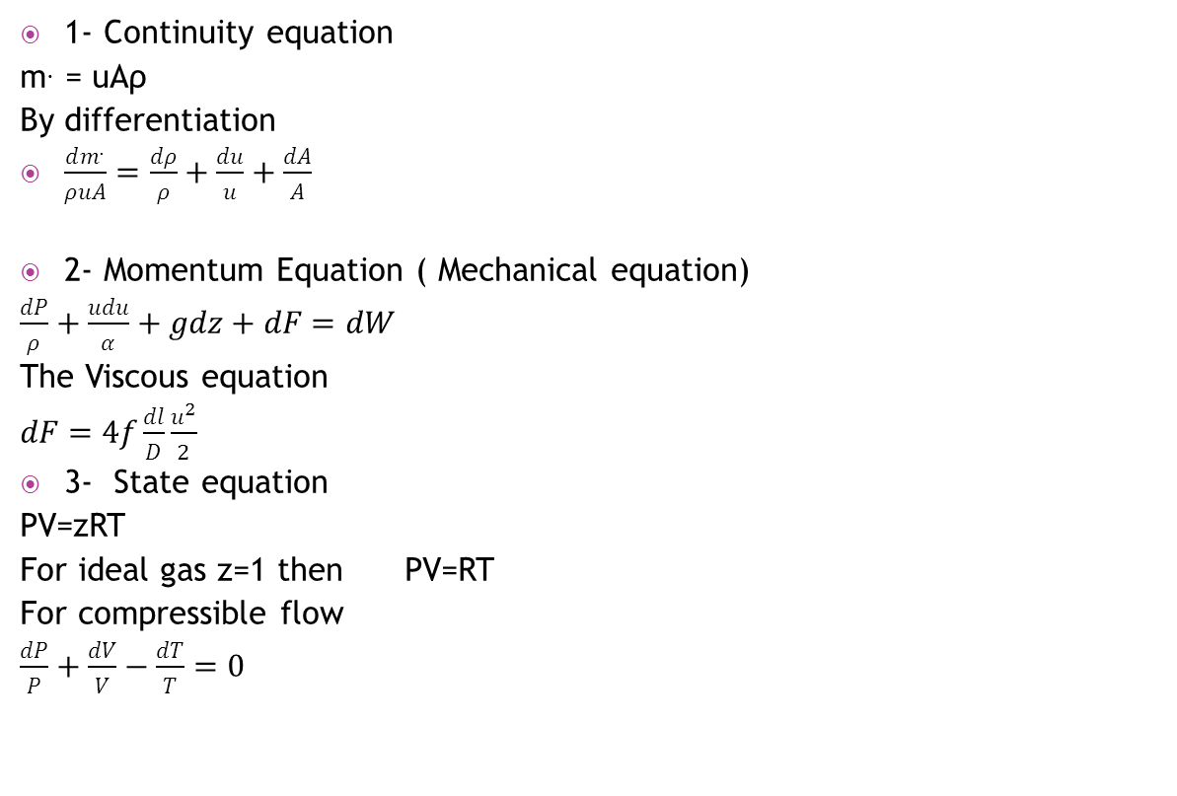
Basic equations
1- Continuity equation
m. = uAρ
By differentiation
$\frac{dm^{.}}{ρuA}=\frac{dρ}{ρ}+\frac{du}{u}+\frac{dA}{A}$
2- Momentum Equation ( Mechanical equation)
$\frac{dP}{ρ}+\frac{udu}{α}+gdz+dF=dW$
The Viscous equation
$dF=4f\frac{dl}{D}\frac{u^{2}}{2}$
3- State equation
PV=zRT
For ideal gas z=1 then PV=RT
For compressible flow
$\frac{dP}{P}+\frac{dV}{V}−\frac{dT}{T}=0$

Slide 14
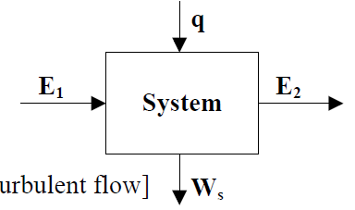
Basic equations
4- Energy Equation
Let E the total energy per unit mass of the fluid where,
E=Internal energy (U)+Pressure energy (Pυ)+Potential energy(zg)+Kinetic energy (u2/2)
Assume the system in the Figure;
Energy balance
E1 + q = E2 + Ws
⇒ E2 – E1 = q – Ws
⇒ ΔU + Δ(Pυ) + gΔ(z) + Δ(u2/2) = q – Ws
[α = 1 for compressible fluid since it almost in turbulent flow]
but ΔH = ΔU + Δ(Pυ)
⇒ ΔH + gΔ(z) + Δ(u2/2) = q – Ws
dH + gd(z) + ud(u) = dq – dWs

Slide 15
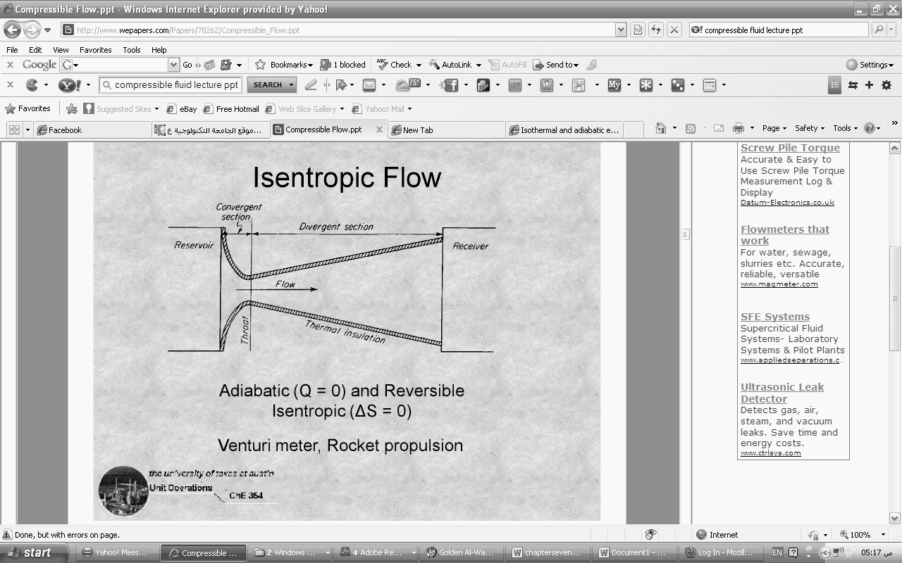
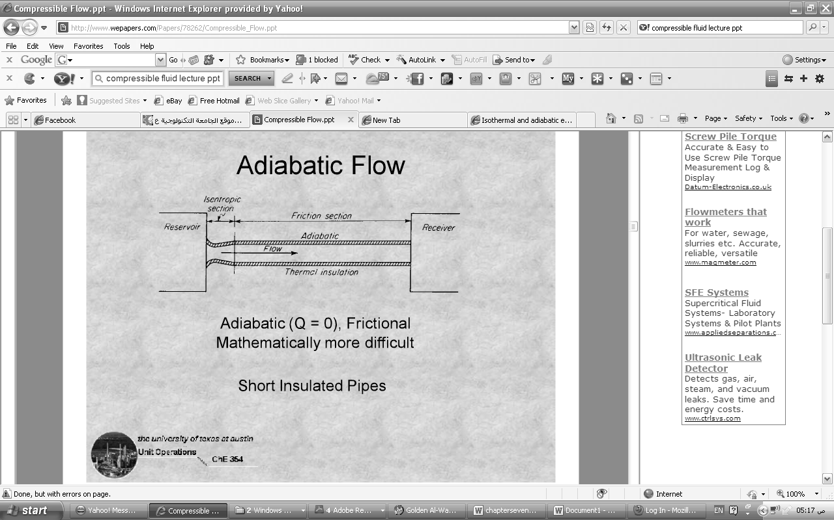
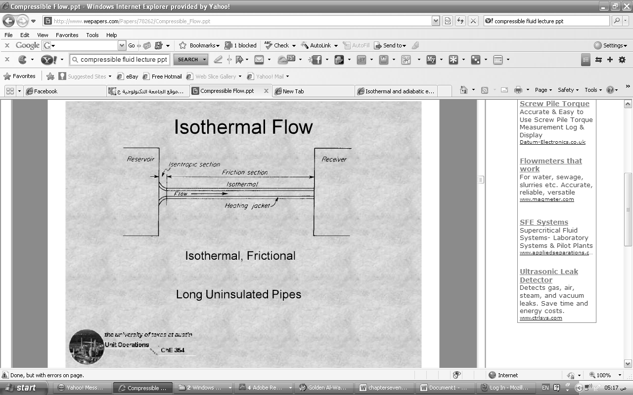
Compressible flow through a pipe

Slide 16
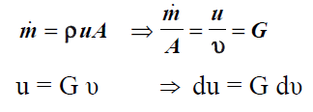

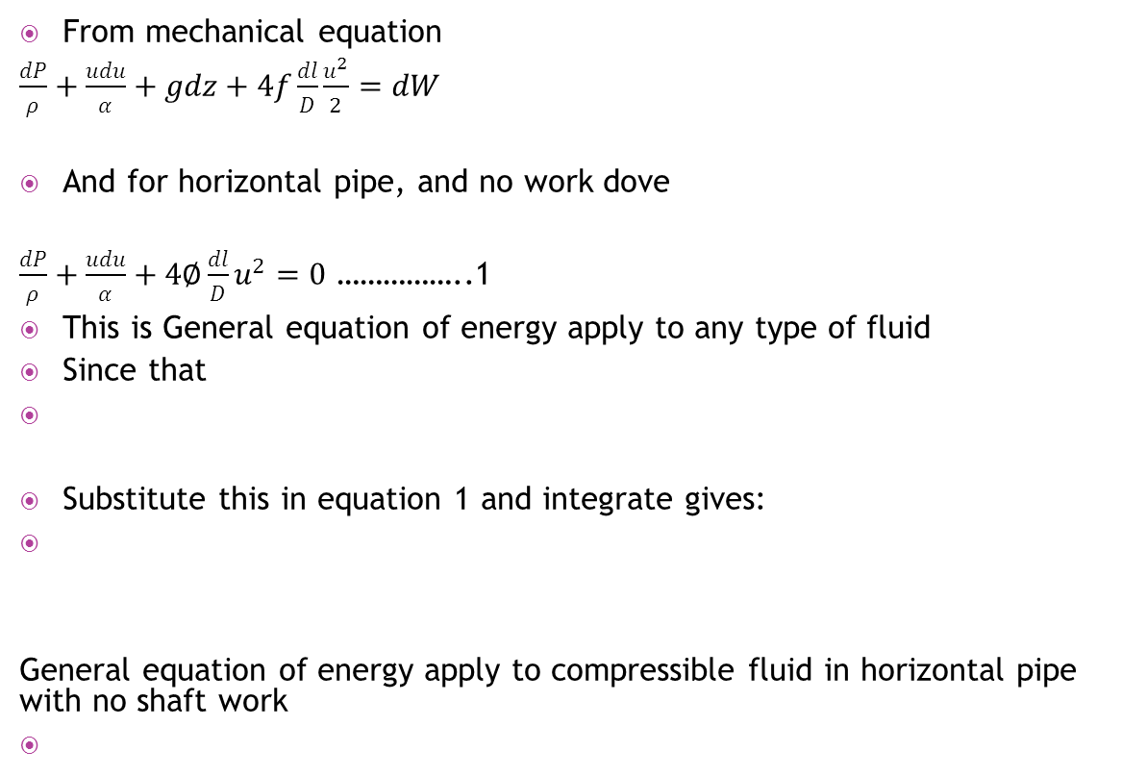
Compressible flow through a pipe
From mechanical equation
$\frac{dP}{ρ}+\frac{udu}{α}+gdz+4f\frac{dl}{D}\frac{u^{2}}{2}=dW$
And for horizontal pipe, and no work dove
$\frac{dP}{ρ}+\frac{udu}{α}+4∅\frac{dl}{D}u^{2}=0$ ……………..1
This is General equation of energy apply to any type of fluid
Since that
Substitute this in equation 1 and integrate gives:
General equation of energy apply to compressible fluid in horizontal pipe with no shaft work

Slide 17



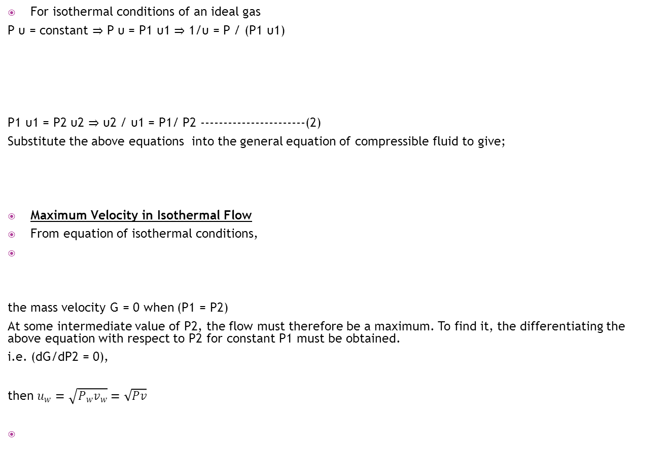
Isothermal Flow of an Ideal Gas in a Horizontal Pipe
For isothermal conditions of an ideal gas
P υ = constant ⇒ P υ = P1 υ1 ⇒ 1/υ = P / (P1 υ1)
P1 υ1 = P2 υ2 ⇒ υ2 / υ1 = P1/ P2 -----------------------(2)
Substitute the above equations into the general equation of compressible fluid to give;
Maximum Velocity in Isothermal Flow
From equation of isothermal conditions,
the mass velocity G = 0 when (P1 = P2)
At some intermediate value of P2, the flow must therefore be a maximum. To find it, the differentiating the above equation with respect to P2 for constant P1 must be obtained.
i.e. (dG/dP2 = 0),
then $u_{w}=\sqrt{P_{w}v_{w}}=\sqrt{Pv}$

Slide 18

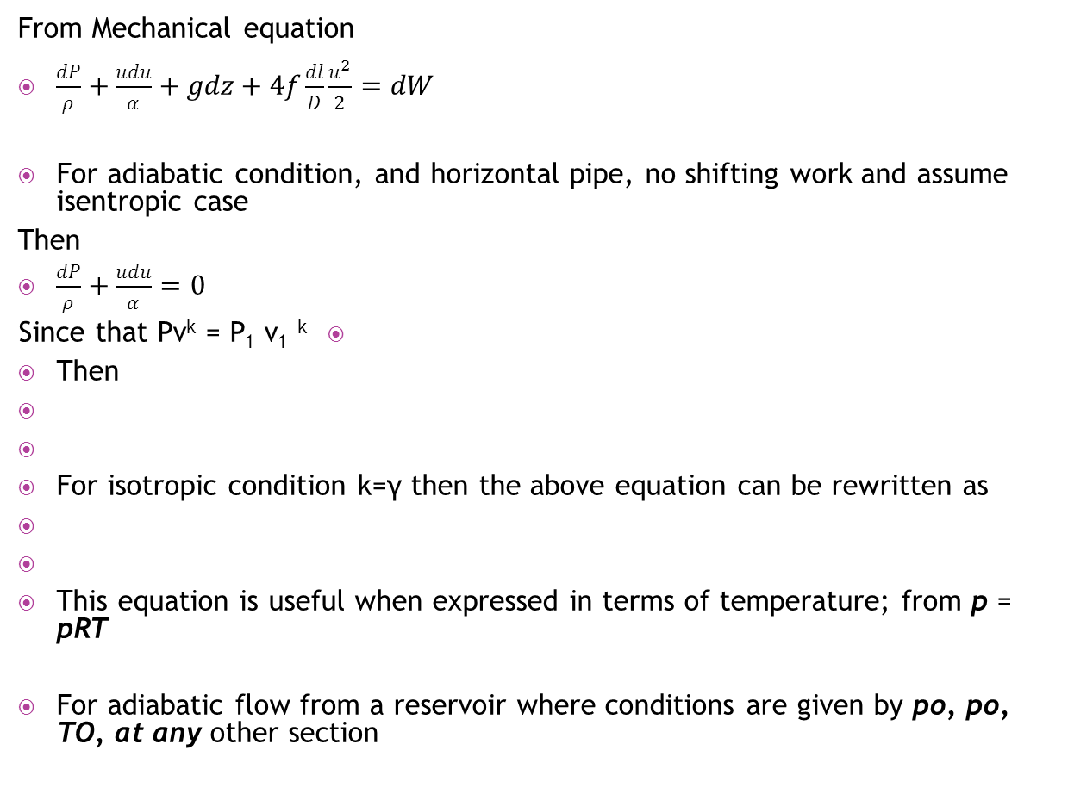
Adiabatic Flow of an Ideal Gas in a Horizontal Pipe
From Mechanical equation
$\frac{dP}{ρ}+\frac{udu}{α}+gdz+4f\frac{dl}{D}\frac{u^{2}}{2}=dW$
For adiabatic condition, and horizontal pipe, no shifting work and assume isentropic case
Then
$\frac{dP}{ρ}+\frac{udu}{α}=0$
Since that Pv^{k} = P₁ v₁^{k}
Then
For isotropic condition k=γ then the above equation can be rewritten as
This equation is useful when expressed in terms of temperature; from p = pRT
For adiabatic flow from a reservoir where conditions are given by po, po, TO, at any other section

Slide 19
In terms of the local Mach number

Slide 20


Maximum Velocity in Adiabatic Flow
For constant upstream conditions, the maximum flow through the pipe is found by differentiating (G) with respect to (υ₂) of the last equation and putting (dG/dυ₂) equal to zero.
The maximum flow is thus shown to occur when the velocity at downstream end of the pipe is the sonic velocity.
Note: -
In isentropic (or adiabatic) flow [P₁υ₁ ≠ P₂υ₂] where, in these conditions [P₁υ₁γ ≠ P₂υ₂ γ]

Slide 21
examples
Example -1-
Over a 30 m length of a 150 mm vacuum line carrying air at 295 K, the pressure falls from 0.4 kN/m² to 0.13 kN/m². If the relative roughness e/d is 0.003 what is the approximate flow rate? Take that μair at 295 K = 1.8 x 10-5 Pa.s
Example -2-
A flow of 50 m³/s methane, measured at 288 K and 101.3 kPa has to be delivered along a 0.6 m diameter line, 3km long a relative roughness e = 0.0001 m linking a compressor and a processing unit. The methane is to be discharged at the plant at 288 K and 170 kPa, and it leaves the compressor at 297 K. What pressure must be developed at the compressor in order to achieve this flow rate? Take that μ_{CH4} at 293 K = 0.01 x 10-3 Pa.s
Example -3-
Town gas, having a molecular weight 13 kg/kmol and a kinematic viscosity of 0.25 stoke is flowing through a pipe of 0.25 m I.D. and 5 km long at arate of 0.4 m³/s and is delivered at atmospheric pressure. Calculate the pressure required to maintain this rate of flow. The volume of occupied by 1 kmol and 101.3 kPa may be taken as 24 m³. What effect on the pressure required would result if the gas was delivered at a height of 150 m (i) above and (ii) below its point of entry into the pipe? e = 0.0005 m.
Example -4-
Nitrogen at 12 MPa pressure fed through 25 mm diameter mild steel pipe to a synthetic ammonia plant at the rate of 1.25 kg/s. What will be the drop in pressure over a 30 m length of pipe for isothermal flow of the gas at 298 K? e = 0.0005 m, μ = 0.02 mPa.s
Example -5-
Hydrogen is pumped from a reservoir at 2 MPa pressure through a clean horizontal mild steel pipe 50 mm diameter and 500 m long. The downstream pressure is also 2 MPa. And the pressure of this gas is raised to 2.6 MPa by a pump at the upstream end of the pipe. The conditions of the flow are isothermal and the temperature of the gas is 293 K. What is the flow rate and what is the effective rate of working of the pump if η = 0.6 e = 0.05 mm, μ = 0.009 mPa.s.
Example -6-
Air flowing through an adiabatic, frictionless duct is supplied from a large supply tank in which P = 500 kPa and T = 400 K. What are the Mach number Ma. The temperature T, density _, and fluid V at a location in this duct where the pressure is 430 kPa?

Slide 22
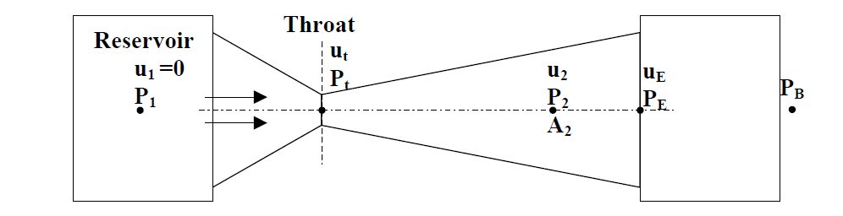
Converging-Diverging Nozzles for Gas Flow
Converging-diverging nozzles, sometimes known as “Laval nozzles”, are used for expansion of gases where the pressure drop is large.
P1: the pressure in the reservoir or initial pressure.
P2: the pressure at any point in diverging section of the nozzle.
PE: the pressure at exit of the nozzle.
PB: the back pressure or the pressure at end.
Pcritical: the pressure at which the velocity of the gas is sonic velocity.

Slide 23

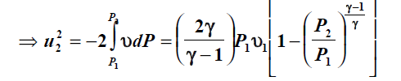



Slide 24

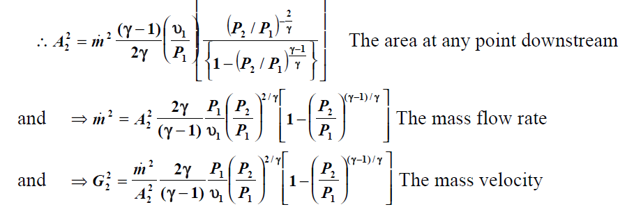
The Pressure and Area for Flow
In converging-diverging nozzles, the area required at any point depend upon the ratio of the downstream to upstream pressure (P2/P1), and it is helpful to establish the minimum value of (At = A2).

Slide 25
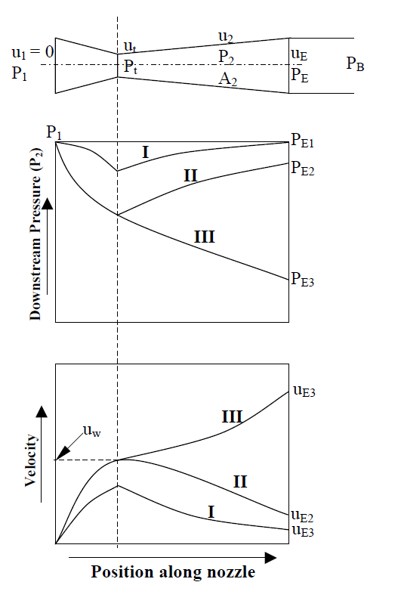
Maximum Velocity and Critical Pressure Ratio
Critical pressure is the pressure at which the gas reaches sonic velocity [i.e. Ma =1.0].
In converging-diverging nozzles, if the pressure ratio (P2/P1) is less than the critical pressure ratio (Pcritical/P1) (usually, ≈ 0.5) and the velocity at throat is then equal to the velocity of sound, the effective area for flow presented by nozzle must therefore pass through a minimum. Thus in a converging section the velocity of the gas stream will never exceed the sonic velocity, though supersonic velocities may be obtained in the diverging section of the converging-diverging nozzle.
Case (I) [PB high, Pt > Pcritical]
The pressure falls to a minimum at throat [lager than critical pressure] and then rises to a value (PE1=PB). The velocity increase to the maximum at throat [less than sonic velocity] and then decreases to a value of (uE1) at the exit of the nozzle. [ Case (I) is corresponding to conditions in a venturi meter operating entirely at subsonic velocities]
Case (II) [PB reduced, PB > (Pt = Pcritical)]
The pressure falls to a critical value at throat where the velocity is sonic. The pressure then rises to a value (PE2=PB) at the exit of the nozzle. The velocity rises to the sonic value at the throat and then falls to a value of (uE2) at the exit of the nozzle.
Case (III) [PB low, PB < (Pt = Pcritical)]
The pressure falls to a critical value at throat and continues to fall to give an exit pressure (PE3=PB). The velocity rises to the sonic value at the throat and continues to increase to supersonic in the diverging section cone to a value (uE3) at the exit of the nozzle.
With converging-diverging nozzle, the velocity increases beyond the sonic velocity [i.e. reach supersonic velocity] only if the velocity at the throat is sonic [i.e. critical pressure at throat] and the pressure at outlet is lower than the throat pressure.

Slide 26
Example -7-
Air enters at a pressure of 3.5 MPa and a temperature of 500ºC. The air flow rate th rough the nozzle is 1.3 kg/s and it leaves the nozzle at a pressure of 0.7 MPa. The expansion of air may be considered adiabatic. Calculate the area of throat and the exit area. Take γ = 1.4.

Slide 27
Fans, Blowers, and Compression Equipment
Fans and blowers are used for many types of ventilating work such as air-conditioning systems. In large buildings, blowers are often used due to the high delivery pressure needed to overcome the pressure drop in the ventilation system.
Blowers are also used to supply draft air to boilers and furnaces.
Fans are used to move large volumes of air or gas through ducts, supplying air to drying, conveying material suspended in the gas stream, removing fumes, condensing towers and other high flow, low pressure applications.
Fans are used for low pressure where generally the delivery pressure is less than 3.447 kPa (0.5 psi), and blowers are used for higher pressures. However they are usually below delivery pressure of 10.32 kPa (1.5 psi). These units can either be centrifugal or the axial-flow type.
The axial flow type in which the air or gas enters in an axial direction and leaves in an axial direction.
The centrifugal blowers in which the air or gas enters in the axial direction and being discharge in the radial direction.
Compressors
Compressor are used to handle large volume of gas at pressures increase from 10.32 kPa (1.5 psi) to several hundred kPa or (psi). Compressors are classified into: -
1- Cotinuous-flow compressors
1-a- Centrifugal compressors
1-b- Axial-flow compressors
2- Positive displacement compressors
2-a- Rotary compressors
2-b- Reciprocating compressors
Since a large proportion of the energy of compression appears as heat in the gas, there will normally be a considerable increase in temperature, which may limit the operation of the compressors unless suitable cooling can be effected. For this reason gas compression is often carried out in a number of stages and the gas is cooled between each stage.

Slide 28
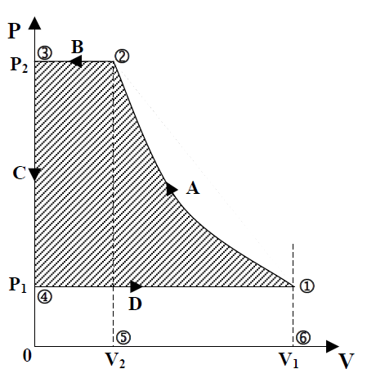
Gas Compression Cycle
Suppose that, after the compression of a volume V1 of gas at P1 to a pressure P2, the whole of the gas is expelled at constant pressure P2, and a fresh charge of gas is admitted at a pressure P1. The cycle can be followed as in Figure, where P is plotted as ordinate against V as abscissa.
Point 1 represents the initial conditions of the gas of pressure and volume of (P1,V1).
  ► A-line 1→2 Compression of gas from (P1,V1) to (P2,V2).
► B-line 2→3 Expulsion of gas at constant pressure P2.
► C-line 3→4 Sudden reduction in pressure in the cylinder
from P2 to P1. As the whole of the gas has been expelled.
► D-line 4→1 A fresh charge of the gas through the suction
stroke of the piston, during which a volume V1 of gas is admitted at constant pressure P1.

Slide 29
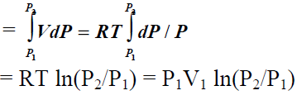
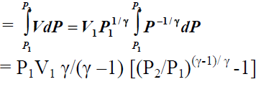
The Total Work Done Per Cycle
Under isothermal conditions
The work of compression for an ideal gas per cycle
􀀄 Under adiabatic conditions
The work of compression for an ideal gas per cycle

