Slide 1
Chapter Six
Non-Newtonian Liquid

Slide 2
Object:
Types of non-Newtonian fluid
Why this happen
Models of non_Newtonian fluid
Frictional losses
Velocity profile
Friction factor

Slide 3
The causes of Non-Newtonian flow depend on the colloid chemistry of the particular product.
In this type of fluid the viscosity changes with shear rate. Apparent viscosity (μ_{a} or η) is always defined by the relationship between shear stress and shear rate.
For many fluids a plot of shear stress against shear rate does not give a straight line. These are so-called “ Non-Newtonian Fluids”. Plots of shear stress against shear rate are experimentally determined using viscometer.
The term viscosity has no meaning for a non-Newtonian fluid unless it is related to a particular shear rate . An apparent viscosity (μa) can be defined as follows:

Slide 4
Types of Non-Newtonian Fluids

Slide 5
Types of Non-Newtonian Fluids
There are two types of non-Newtonian fluids: -
Time-independent.
Time-dependent.
Time- independent liquid
Fluids for which the rate of shear at any point is determined only by the value of the shear stress at that point at that instant; these fluids are variously known as “time independent”, “purely viscous”, “inelastic”, or “Generalised Newtonian Fluids” (GNF).
Conversely, one can say that such fluids have no memory of their past history. i.e ,the apparent viscosity depends only on the rate of shear at any particular moment and not on the time for which the shear rate is applied.
The relationship between shear stress and shear rate is more complex and this type can be written as: -

Slide 6
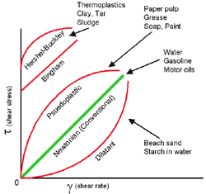
There are three types of it (as shown in figure):
1. Shear- thinning or pseudoplastic behavior The apparent viscosity of the fluid decreases with an increase in shear rate. [power-law n<1] Ex. Polymer solution, detergent, Orange juice concentrate, Banana puree , CMC
τ_{yx} = m(γ_{yx})^{n}
where
m = fluid consistency coefficient
n = flow behaviour index

Slide 7
2. Visco-plastic behavior with or without shear-thinning behavior it required (τ°) for initial flow
Viscoplastic fluids behave as if they have a yield stress (t0). Until t0
is exceeded they do not appear to flow. A Bingham plastic fluid has
a constant plastic viscosity
Ex., soap, sewage sludge, toothpaste, Tomato paste
3. Shear- thickening or dilatant behavior The apparent viscosity of the fluid increases with an increase in shear rate. [power-law n>1]
Ex. Chocolate mixture,Wet beach sand, starch in water..

Slide 8
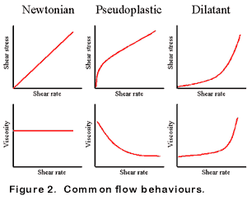
Common flow behavior

Slide 9
Time-Dependent Non-Newtonian Fluids
More complex fluids for which the relation between shear stress and shear rate depends, in addition, on the duration of shearing and their kinematic history; they are called “time-dependent fluids”.
For this type the curves of share stress versus shear rate depend on how long the shear has been active. This type is classified into: -
1- Thixotropic Fluids
Which exhibit a reversible decrease in shear stress and apparent viscosity with time at a constant shear rate. Ex. Paints.
2- Rheopectic Fluids
Which exhibit a reversible increase in shear stress and apparent viscosity with time at a constant shear rate. Ex. Gypsum suspensions, bentonite clay.

Slide 11
With respect to non-newtonian fluids, we need to answer the following questions:
• What is the pressure drop across a pipe?
• What is the average velocity?
• What is the velocity profile?
• How can I determine the friction factor for these fluids?

Slide 12
Flow Characteristic [8u/d]
for Newtonian fluid of laminar flow through a circular pipe
For non-newtonian time independent fluid
Or
where, Kp′ and n′ are point values for a particular value of the flow characteristic (8u/d), (μa)P is apparent viscosity for pipe flow.
This equation gives a point value for the apparent viscosity of non-Newtonian fluid flow through a pipe.

Slide 13
Reynolds number for the of non-Newtonian fluids can be written as
These equations give a point value for Re at a particular flow
characteristic (8u/d).
Pressure Drop
The pressure drop due to skin friction can be calculated in the same way as for Newtonian fluids,
–ΔPfs = 4f (L/d) (ρu²/2)
This is used for laminar and turbulent flow
Friction Factor
A point value of the basic friction factor (Φ or Jf) or fanning friction factor (f ) for laminar flow can be obtained from;
Φ = J_{f} = 8 / Re or f =16 / Re

Slide 14
the fanning friction factor (f ) for turbulent flow of general time independent non-Newtonian fluids in smooth cylindrical pipes can be calculated from;
f = a / Reb
where, a, and b are function of the flow behavior index (n′)
There is another equation to calculate (f ) for turbulent flow of time-independent non-Newtonian fluids in smooth cylindrical pipes;

Slide 15
Flow of Power-Law Fluids in Pipes
Power-law fluids are those in which the shear stress (τ) is related to the shear rate () by this equation;
for power-law fluids the parameters Kp′ and n′ are no longer point values but remain constant over a range of (8u/d), so that for power-law fluids the shear stress at wall can be written as;
where,
Kp: is the consistency coefficient for pipe flow.
n: is the power-law index.

Slide 16
The shear rate at pipe wall for general time-independent non-Newtonian fluids is;
and for power-law fluids;
the relationship between the general consistency coefficient (K) and the consistency coefficient for pipe flow (Kp).
The apparent viscosity for power-law fluids in pipe flow
The Reynolds number for non-Newtonian fluids flow in pipe
For power –law fluids flow in pipes the Re can be written either as;

Slide 17
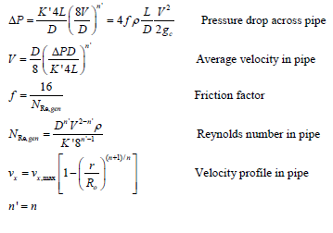
Laminar flow of power-law non-newtonian liquid

Slide 18
Friction Losses Due to Form Friction in Laminar Flow
1-
Kinetic Energy in Laminar Flow
Average kinetic energy per unit mass = u2/2α [m2/s2 or J/kg]
α = 1.0 -------------in turbulent flow
-------------in laminar flow
- For Newtonian fluids (n = 1.0) ⇒ α = 1/2 in laminar flow
- For power-law non-Newtonian fluids (n < 1.0 or n > 1.0)
Losses in Contraction and Fittings
The frictional pressure losses for non-Newtonian fluids are very similar to those for Newtonian fluids at the same generalized Reynolds number in laminar and turbulent flow for contractions and also for fittings and valves.
Losses in Sudden Expansion
For a non-Newtonian power-law fluid flow in laminar flow through a sudden expansion from a smaller inside diameter d1 to a larger inside diameter d2 of circular cross-sectional area, then the energy losses is

Slide 19
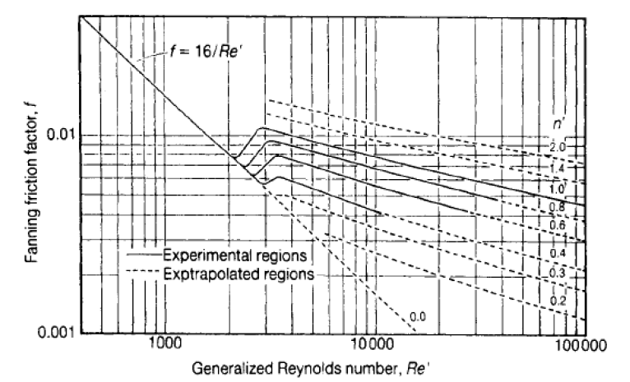
Friction Factor of power-law non-newtonian liquid
The fanning friction factor is plotted versus the generalized Reynolds number. Since many non-Newtonian power-law fluids have high effective viscosities, they are often in laminar flow. The correction for smooth tube also holds for a rough pipe in laminar flow
For rough pipes with various values of roughness ratio (e/d), this figure can not be used for turbulent flow, since it is derived for smooth pipes..

Slide 20
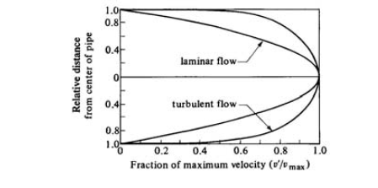
Turbulent Flow
Turbulent flow modeling for liquids is very difficult. Turbulence
creates turbulent eddies which are difficult to predict and model. The
velocity distributions for turbulent flow are a lot flatter than for
laminar flow.

Slide 21
Example 1
A coal slurry is to be transported by horizontal pipeline. It has been determined that the slurry may be described by the power law model with a flow index of 0.4, an apparent viscosity of 50 cP at a shear rate of 100 /s, and a density of 90 lb/ft3. What horsepower would be required to pump the slurry at a rate of 900 GPM through an 8 in. Schedule 40 pipe that is 50 miles long ?
Example 2
A general time-independent non-Newtonian liquid of density 961 kg/m3 flows steadily with an average velocity of 1.523 m/s through a tube 3.048 m long with an inside diameter of 0.0762 m. For these conditions, the pipe flow consistency coefficient Kp' has a value of 1.48 Pa.s^{0.3} [or 1.48 (kg / m.s²) s^{0.3}] and n' a value of 0.3. Calculate the values of the apparent viscosity for pipe flow (μa)P, the Reynolds number Re and the pressure drop across the tube, neglecting end effects.

Slide 22
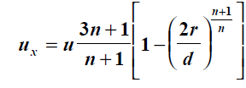
Example 3
A Power-law liquid of density 961 kg/m3 flows in steady state with an average velocity of 1.523 m/s through a tube 2.67 m length with an inside diameter of 0.0762 m. For a pipe consistency coefficient of 4.46 Pa.s^{n} [or 4.46 (kg / m.s²) s^{0.3}], calculate the values of the apparent viscosity for pipe flow (μa)P in Pa.s, the Reynolds number Re, and the pressure drop across the tube for power-law indices n = 0.3, 1.0, and 1.5 respectively.
Example4
A pseudoplastic fluid that follows the power-law, having a density of 961 kg/m3 is flowing in steady state through a smooth circular tube having an inside diameter of 0.0508 m at an average velocity of 6.1 m/s. the flow properties of the fluid are n′ = 0.3, Kp = 2.744 Pa.s^{n}. Calculate the frictional pressure drop across the tubing of 30.5 m long.
Example4
The laminar flow velocity profile in a pipe for a power-law liquid in steady state flow is given by the equation
where n is the power-law index and u, is the mean velocity.
Use this equation to drive the following expression
For the velocity gradient at the pipe walls.

