Slide 1
Fluid Mechanic
By
Dr. ASAWER A. ALWASITI

Slide 2
CONTENTS
CHAPTER ONE: Introduction
CHAPTER TWO: Dimensionless Analysis
CHAPTER THREE: Fluid Statics And Its Application
CHAPTER FOUR: Fluid Dynamic
CHAPTER FIVE : Flow-Measurement
CHAPTER SIX: Non- Newtonian Fluid
CHAPTER SEVEN: Compressible Fluid in Pipes
CHAPTER EIGHT: Pumping of Liquids
CHAPTER NINE: Flow in Porous Media

Slide 3
REFERENCES
1- E. Bobok, “Fluid Mechanics in Petroleum Engineering”, 1993
2- Streeter,V. ”Fluid Mechanic”,3rd edition, Mc-Graw Hill, 1962.
3- Holland, F.A. “Fluid Flow for Chemical Engineers” Arnold, (1980).
4- Frank M. White “Fluid Mechanics” 5th edition McGraw Hill.
5- Coulson, J.M. and J.F. Richardson, “Chemical Engineering”, Vol.I “ Fluid Flow, Heat Transfer, and Mass Transfer” 5th edition, (1998).

Slide 4
Chapter One Introduction
Fluid : is a substance which deforms continuously under the influence of shearing forces or shear stress, it includes liquid and gases.
A stress is defined as a force per unit area, acting on an infinitesimal surface element. It has both magnitude (force per unit area) and direction , and the direction is relative to the surface on which the stress acts.

Slide 5
Pressure is an example of a normal stress, and acts inward, toward the surface, and perpendicular to the surface.
Shear stress is an example of a tangential stress, i.e. it acts along the surface, parallel to the surface.
Friction due to fluid viscosity is the primary source of shear stresses in a fluid.

Slide 6
Solid and Fluid Distinction
-Molecular of solid are much closer together than fluid
-Solid tries to return to its original shape due to large attraction between solid molecules
-Fluids have very week inter-molecular attraction so that fluids flow under the applied force.
Fluid Mechanic is a study of what will happen when a force applied on a fluid when its rest or moving.

Slide 7
Liquids differs greater resistance to compression change while gases are easily to compressed
Liquid | Gas
Almost incompressible Forms a free surface area | Easy to compressed Fills any vessel in which it placed

Slide 8
Fundamental Quantities of Fluid
Dimension: Generalization of “unit” telling us what kind of units are involved in a quantitative statement
The primary quantities of fluid are:
Quantity | Dimension | Units
Mass | M | kg, gm, Ib
Length | L | km, m, ft
Time | T | s, hr
Temperature | θ | C, K, cal
Derived quantity
Force (mass*acceleration) | F=MLT⁻² | N, dyn, Ib_{f}

Slide 9
System Unit
System | Mass | Length | Time | Force
System International (SI) | kg | m | s | N
French System | gm | cm | s | dyn
British Gravitational (BG) | slug | ft | s | Ib_{f}
English Engineer (EE) | Ib_{m} | ft | s | pdl

Slide 10
Properties of Fluid
Density
The density of fluid is the mass per unit volume, its denoted as ρ with units kg/m³, Ib/ft³
Densities of fluids decrease with temperature and nearly constant (incompressible) for constant
temperature while densities of gasses increase with pressure
Specific Volume
Its is the ratio of the volume of fluid to its mass, its reciprocal of density and denoted as υ(apsilon)
with units of; m­³/kg, ft³/Ib

Slide 11
Properties of Fluid
Specific Weight
It is the ratio of weight of fluid to its volume, its denoted as sp.wt with units of, N/m², Ib_{f}/ft³
Specific Gravity
It is a ratio of density of a fluid to the density of water, its denoted as sp.gr and its dimensionless
Dynamic Viscosity
It is fluid properties that offers resistance to the movement of one layer of fluid over another adjacent
layer of the fluid, its denoted as μ(mu) and its common units are (kg/m.s), (g/cm.s), (lb/ft.s), (poise)
(N.s/m2 ≡ Pa.m), (dyne.s/cm2). [poise ≡ g/cm.s ≡ dyne.s/cm2] [poise = 100 c.p]
Its caused by intermolecular cohesion for liquid and molecular activity for gases
Kinematic Viscosity
It is a ratio of dynamic viscosity to the density of fluid, its denoted as γ(nu)and its unit are (m2/s), (cm2/s),
(ft2/s), (stoke). [stoke ≡ cm2/s] [stoke = 100 c.stoke]

Slide 12
Properties of Fluid
Surface Tension
It is the liquid property that creates the capability of resisting tension at the interface between two different liquids or at the interface between liquid and gas. Its denoted as ( σ) (sigma) and its unit is N/m
Cohesion : molecular attraction between the
molecules of the same material. Forms an
imaginary film capable of resisting tensile stress
at the interface.
Adhesion : molecular attraction between the
molecules of the liquid and the solid surface
which is in contact with the liquid.

Slide 13
Properties of Fluid
Vapor Pressure
When a liquid in a closed container ,small air space, a pressure will developed in the space as a result of vapor that is formed by escaping molecules.
When equilibrium is reached so that the molecules leaving the surface is equal to the entering – vapor is said to be saturated and the pressure exerted by the vapor on the liquid surface is termed as vapor pressure.
It increase with temperature
Its called vapor pressure or vapor saturated pressure
Its called partial pressure when its mixed with other gases
The temperature at which the vapor pressure is equal to the atmospheric pressure is called the boiling point.

Slide 14
Properties of Fluid
Compressibility
Compressibility (K) is defined as the relative change in fluid volume per unit external pressure change. It relates to variability of density
􀂄 Compressible - variable density
􀂄 Incompressible - constant density

Slide 15
In summary the quantities of fluid are
Quantity | Symbol | Dimension
Density | ρ | ML⁻³
Specific Volume | υ | L³M⁻¹
Specific weight | sp.wt | FL⁻³= ML⁻²T⁻²
Specific gravity | sp.gr | -
Dynamic viscosity | μ | FTL⁻² = MT⁻¹ L⁻¹
Kinematic viscosity | γ | L²T⁻¹
Surface tension | σ | FL⁻¹= MT⁻²

Slide 16
Useful Information
1-The shear stress [symbol: τ (tau)]
It is the force per unit surface area that resists the sliding of the fluid layers.
The common units used of shear stress is (N/m² ≡ Pa), (dyne/cm²), (lbf/ft²).
2- The pressure [symbol: P]
It is the force per unit cross sectional area normal to the force direction.
The common units used of shear stress is (N/m2 ≡ Pa), (dyne/cm2), (lbf/ft2) (atm) (bar) (Psi) (torr ≡ mmHg). The pressure difference between two points refers to (ΔP).
The pressure could be expressed as liquid height (or head) (h) where,
P=ghρ and ΔP=gΔhρ
h: is the liquid height (or head), units (m), (cm), (ft).
3-The energy [symbol: E]
Energy is defined as the capacity of a system to perform work or produce heat.
There are many types of energy such as [Internal energy (U), Kinetic energy (K.E), Potential energy (P.E), Pressure energy (Prs.E), and others.
The common units used for energy is (J ≡ N.m), (erg ≡ dyne.cm), (Btu), (lbf.ft) (cal).
The energy could be expressed in relative quantity per unit mass or mole (J/kg or mol).
The energy could be expressed in head quantity [(m) (cm) (ft)] by dividing the relative energy by acceleration of gravity.

Slide 17
Useful Information
4-The Power [symbol: P]
It is the energy per unit time. The common units used for Power is (W ≡ J/s), (Btu/time), (lbf.ft/time) (cal/time), (hp).
5. The flow rate
Volumetric flow rate [symbol: Q]
It is the volume of fluid transferred per unit time.
Q= Au
where A: is the cross sectional area of flow normal to the flow direction. The common units used for volumetric flow is (m³/s), (cm³/s), (ft³/s).
Mass flow rate [symbol: m&]
It is the mass of fluid transferred per unit time. m&=Qρ=ρAu
The common units used for volumetric flow is (kg/s), (g/s), (lb/s).
Mass flux or (mass velocity) [symbol: G]
It is the mass flow rate per unit area of flow, G=m&/A= ρu
The common units used for mass flux is (kg/m².s), (g/cm².s), (lb/ft².s).

Slide 18
Important Laws
Law of conservation of mass
“ The mass can neither be created nor destroyed, and it can not be created from nothing”
Law of conservation of energy
“ The energy can neither be created nor destroyed, though it can be transformed from one form into another”
Newton’s Laws of Motion
Newton has formulated three law of motion, which are the basic postulates or assumption on which the whole system of dynamics is based.
Newton’s first laws of motion
“Every body continues in its state of rest or of uniform motion in a straight line, unless it is acted upon by some external forces”
Newton’s second laws of motion
“The rate of change in momentum is directly proportional to the impressed force and takes place in the same direction in which the force acts”[momentum = mass × velocity]
Newton’s third laws of motion
“To every action, there is always an equal and opposite reaction”
First law of thermodynamics
“Although energy assumes many forms, the total quantity of energy is constant, and when energy disappears in one form it appears simultaneously in other forms”

Slide 19
Fluid Classification
Fluid can be classified in many ways as:
Liquid and gases
Its classified into gas and liquid according to the molecular structure.
Continuum and Discrete
In continuum fluid the individual molecular properties are negligible
In discrete fluid each molecular treated separately
Perfect (ideal) and real fluid
Perfect or Ideal fluid
It is one that is incompressible having no viscosity (μ = 0). Ideal fluid is only an imaginary fluid since all the fluids,
which exist, have some viscosity.
Real fluid
A fluid, which possesses viscosity, is known as real fluid. All the fluids, an actual practice, are real fluids.
Compressible and incompressible fluid
In compressible fluid density changes with applied pressure
In incompressible fluid density doesn’t changed by external pressure.
Steady and Unsteady fluid flow
Steady fluid: the properties of fluid independent on time
Unsteady fluid: the properties of fluid varies with time
Newtonian and non-Newtonian fluid
Basing on the viscosity, the fluid can be classified to Newtonian and non-Newtonian fluid

Slide 20
Newton’s Law of Viscosity and Momentum Transfer
Newtonian and non-Newtonian fluids

Slide 21
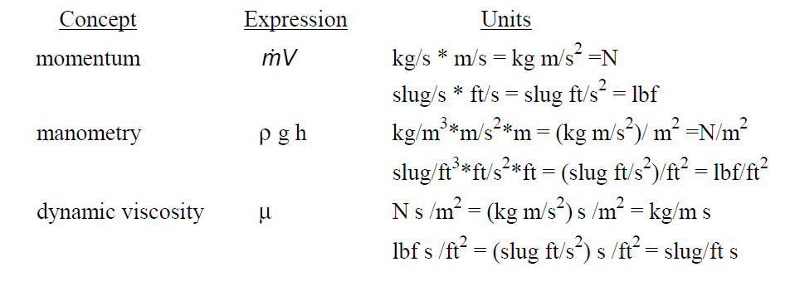

Slide 22
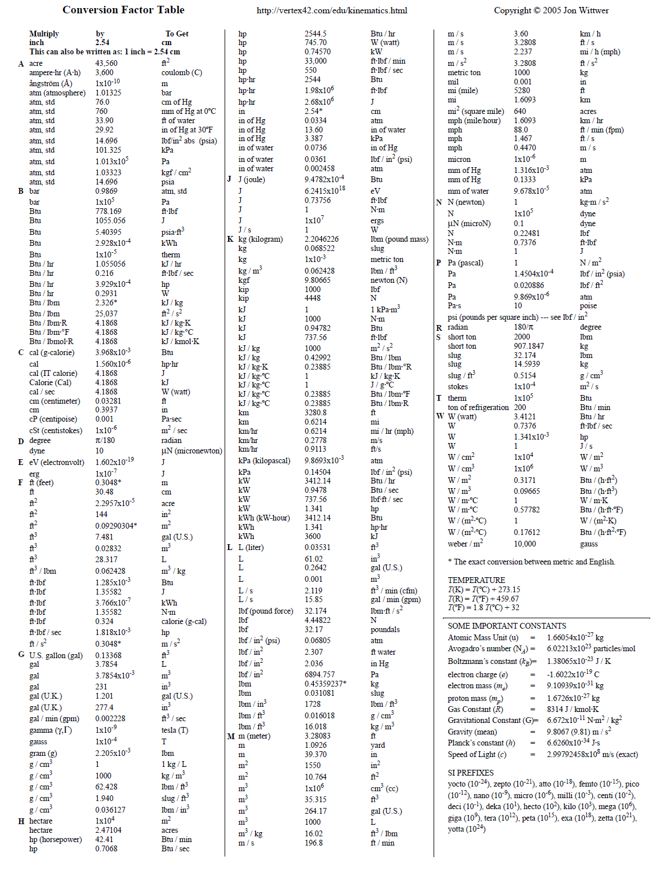

Slide 23
Examples
1- Convert the following:
a. A discharge of 20ft³/min to lit/sec.
b. A force of 10poundals to dynes.
c. A pressure of 30lb/in² to gm/cm².
d. A specific weight of 62.4lb/ft³ to kg/lit.
2- Determine the specific weight, density and specific gravity of a liquid that occupies a
volume of 200lit., and weighs 178kg. Will this liquid float on the surface of an oil of
specific gravity (0.8)? Provide results in SI units.
3- One liter of certain oil weighs 0.8 kg, calculate the specific weight, density, specific volume,
and specific gravity of it.
4-Determine the specific gravity of a fluid having viscosity of 4.0 c.poice and kinematic viscosity of 3.6 c.stokes.
5- The velocity distribution of a viscous liquid (μ=0.9N.s/m²) over a fixed boundary is approximately
given by: v = 0.98y - y2 in which y is the vertical distance in meters, measured from the boundary
and v is the velocity in m/s.Determine the shear stress at the surface and at y=0.34m.
Sketch the velocity and shear stress profiles for the given flow.
6- A fluid has a viscosity 1.5cp flows between two parallel plates with velocity 0.8m/s, if the distance
between the plates is 0.1mm and the surface area of the plate 3*10³cm². Find the force required
to maintain the speed.

