Slide 1
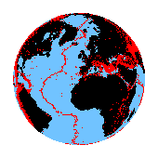
Republic of Iraq
Ministry of Oil
Petroleum Research and Development Center
PRDC

Slide 2
PRDC
PRDC Activities.
Main Corrosion Problems in Iraqi Oil Fields.
Facilities and Main Equipments in Corrosion Lap.
Studies and Researches.
PRDC Ambitions.

Slide 3
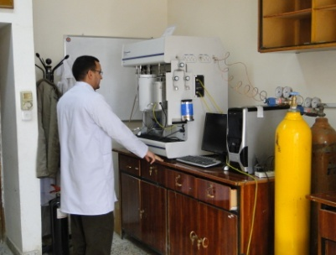
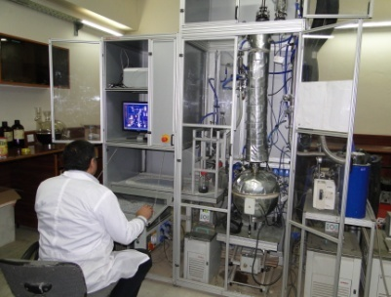
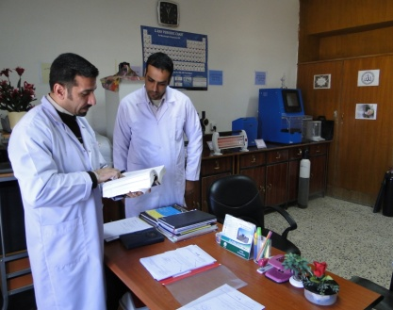
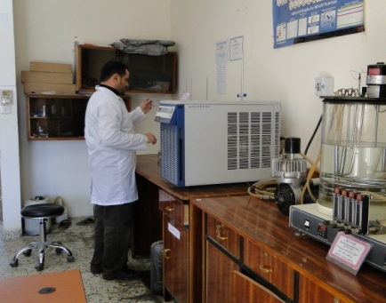
PRDC

Slide 4
PRDC
PRDC ACTIVITIES
Petroleum research & development centre is one of the ministry of oil constructions. It was established in 1992 .The centre is occupying two multi layer buildings, More than 27 laboratories, 50 cabinets, stores, meeting rooms, conferences hall, power plant & other facilities. The strategy of the centre is to provide scientific and technical support to all petroleum industry activities by doing researches and practical studies to solve difficulties & to keep regular development for this industry.

Slide 5
PRDC
PRDC ACTIVITIES
After 2003 Iraq has been opened on the world and a lot of essential changes happened in the objectives of PRDC and they have been focused on solving the technical problems facing the petroleum industry, transforming technology, environmental protection, corrosion problems which are more important than manufacturing substitution materials.
Before 2003 the efforts of the centre were focused on finding and manufacturing substitutions for imported and unavailable materials needed in petroleum sector.
before 2003
after 2003

Slide 6
Director Manager
PRDC
PRDC
Organization
Legal
Unit
Issues Section
Media
Unit
Secretary Unit
Safety section
Warehouse & Purchasing Section
Administration department
Financial department
Analytical lab departmen
Environmental & corrosion research department
up stream research department
Internal auditing department
Refining & gas industry research department
Engineering & technical affair department
Planning & follow-up department
Ph.D = 4 M.Sc.= 18 B.Sc. =146

Slide 7
PRDC
Main Corrosion Problems in Iraqi Oil Industries
The Iraqi oil field environment is filled with metal pipes and other components that often exposed to chemicals that can cause corrosion, especially when the metal and chemicals are in a solution such as down hole fluids.
There are four general types of corrosion of concern in the Iraqi oil field. These involve three chemicals of concern and electrochemical corrosion. The types of corrosion which commonly occur in Iraqi petroleum industry include:

Slide 8
PRDC
Hydrogen Sulfide Corrosion
Oxygen Corrosion
Carbon Dioxide Corrosion
Electrochemical Corrosion

Slide 9
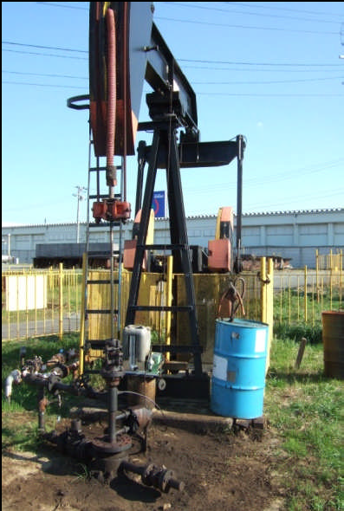
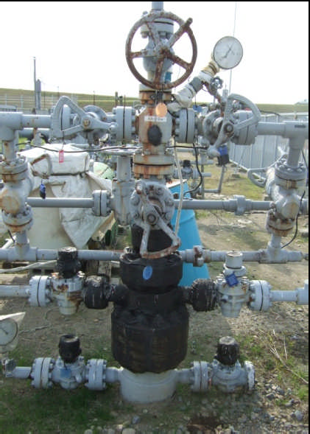
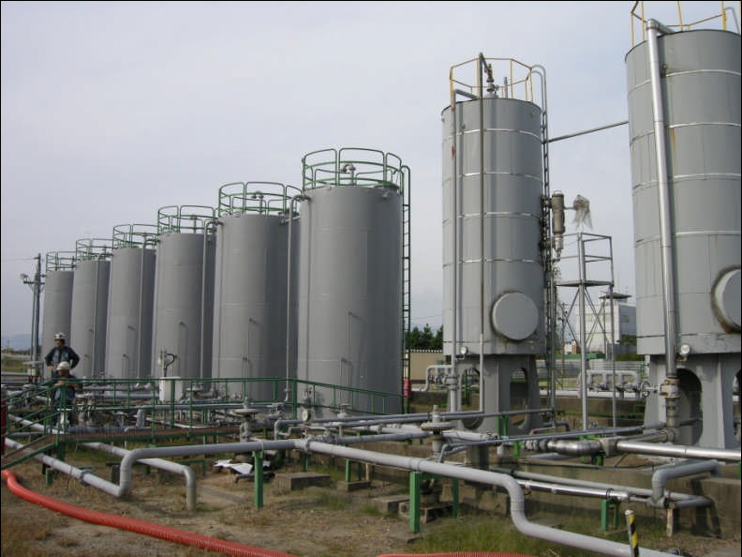
PRDC
Corrosion problems can be appeared in oil industries in the following positions
Oil well
Crude oil tank
Injection well

Slide 10
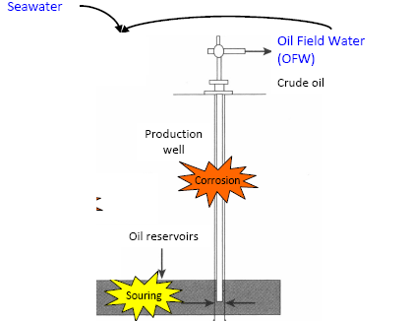
PRDC

Slide 11
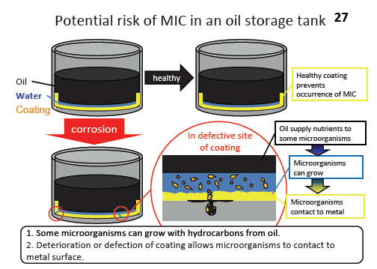
PRDC

Slide 12
PRDC
Laboratory Facilities
in
PRDC
for
Corrosion Field

Slide 13
PRDC
The Corrosion laboratories are Head Unit in the Environment and Corrosion Department in PRDC.
The tasks of this unit are :-
Evaluation of Corrosion problems in Iraqi petroleum companies.
Synthesis of corrosion Inhibitors and antioxidants that may be used in petroleum industries.
Evaluation of chemicals used as Corrosion and Scale Inhibitors for the chemicals imported by Iraqi petroleum companies.

Slide 14
PRDC
Corrosion Technology Labs.
Identification of
Corrosion Problems
Evaluation
of
Corrosion Inhibitors
Synthesis of Anti oxidants
and Corrosion Inhibitors

Slide 15
PRDC
Main Equipments in
Corrosion Unit Labs.

Slide 16
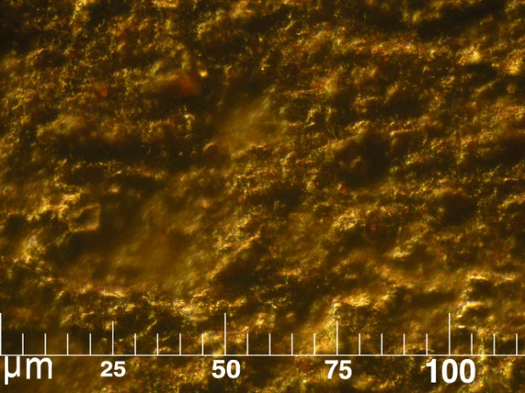
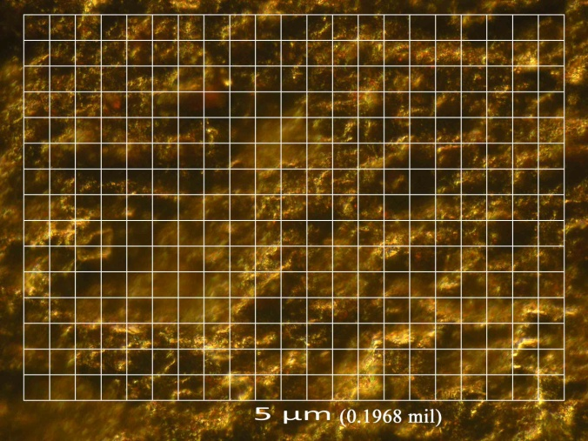
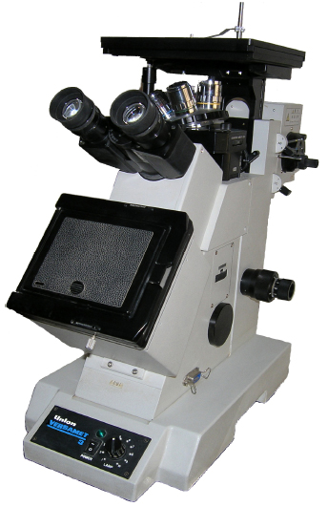
PRDC
METALLOGRAPH MICROSCOPE
-(50 – 2000)X.
- Bright & Dark field.
-Polarized.
-Nomarski Prisms.
-Transparence & Dark Coupons.
-Digital camera for photography.
-micrometer scales can applied to the photos.
Production Company: THERMO Scientific

Slide 17
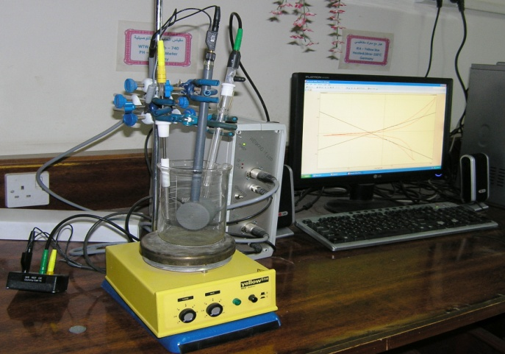
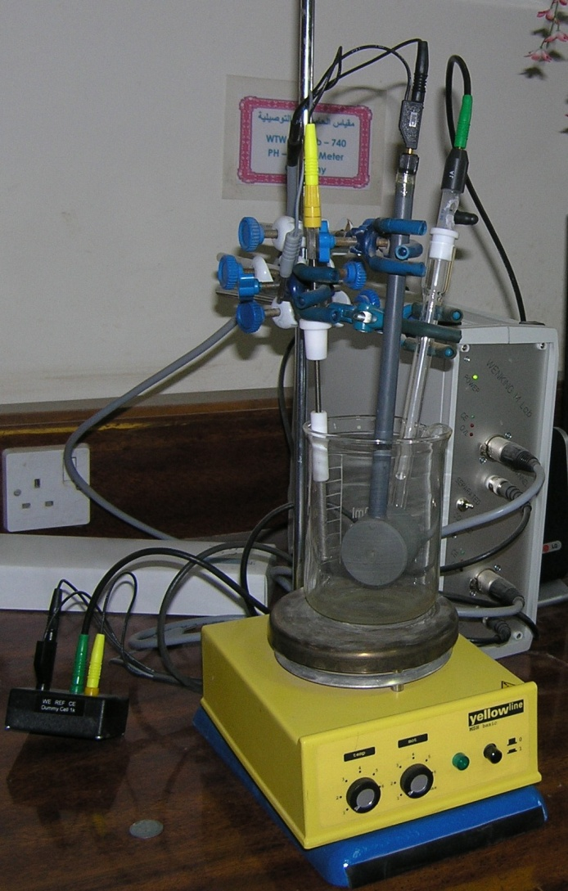
PRDC
POTENTIO STAT. M. LAB.
Determination of corrosion rate for different medias. by applied of an electrical potential on the constant surface area of metal to evaluate the corrosion ability of the metal..
Specifications
Computerize.
Two channels each one contain three columns (Reference electrode, Work electrode & Counter electrode).
Production Company : Bank Elekronik

Slide 18
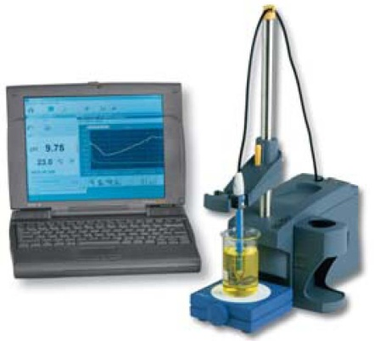
PRDC
Conductivity and PH meter
Measuring of aqueous solutions conductivity, salinity and total dissolved salts(T.D.S) and Measuring of acid number for aqueous solution
Production company : WTW

Slide 19
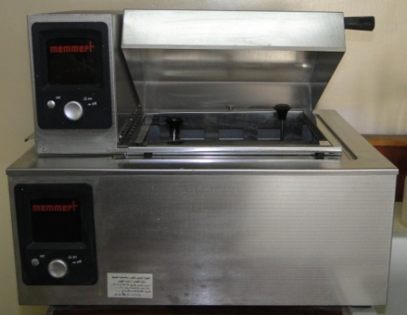
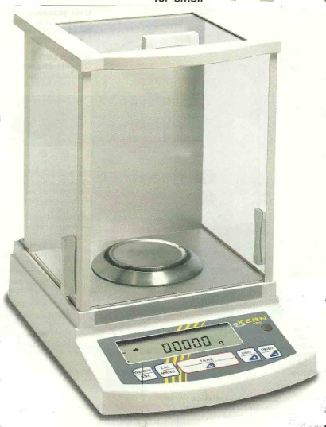
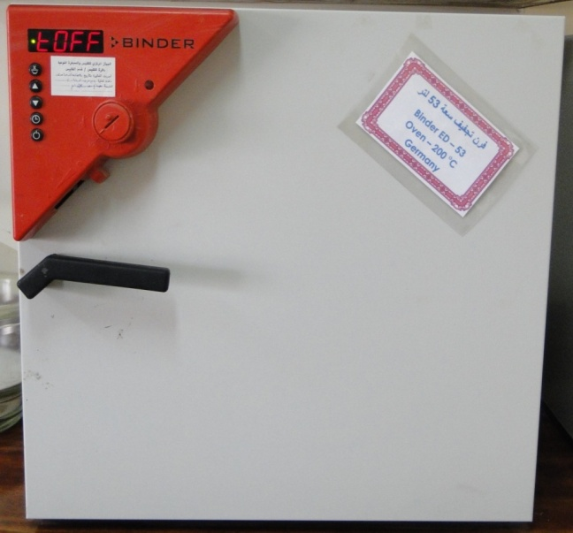
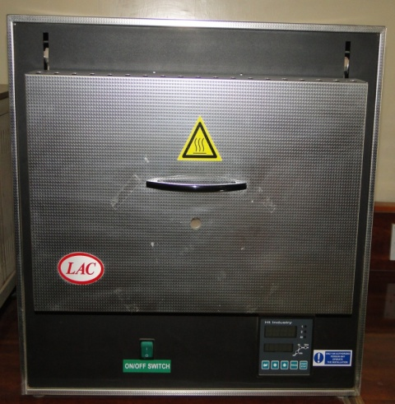
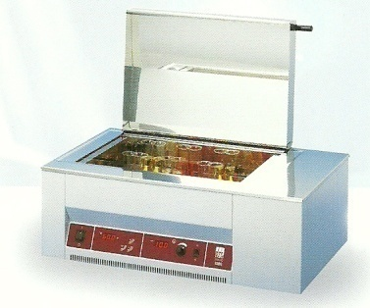
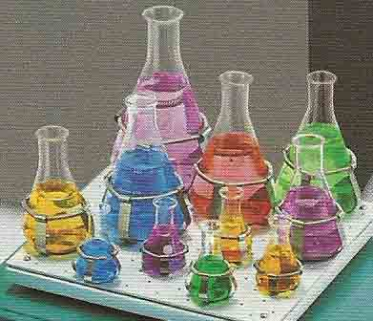
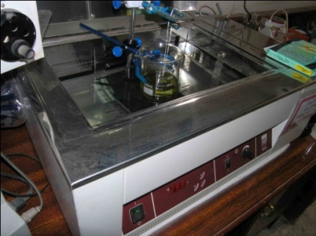
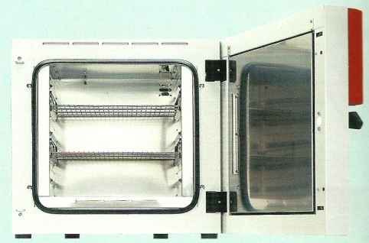
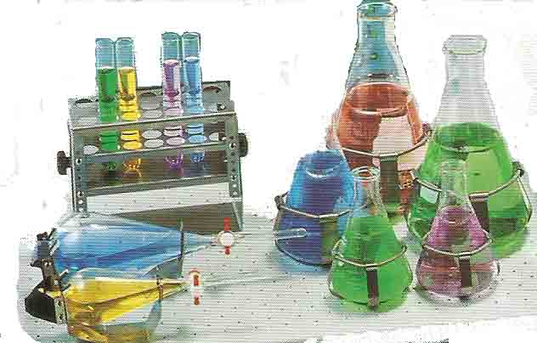
PRDC
Other Equipments in the Lab.

Slide 20
PRDC
Cooperation Projects

Slide 21
PRDC
National Co-operation Horizons
PRDC has memorandum of understanding (MoU.) with;
Basra university / Marin Science Center.
Triple MoU. (PRDC, SOC, Baghdad University).
Baghdad University/ chemical engineering department.
University of technology.
Ibn- Alhaytham college of education.
Mining & geologic survey.
Baghdad province council.

Slide 22
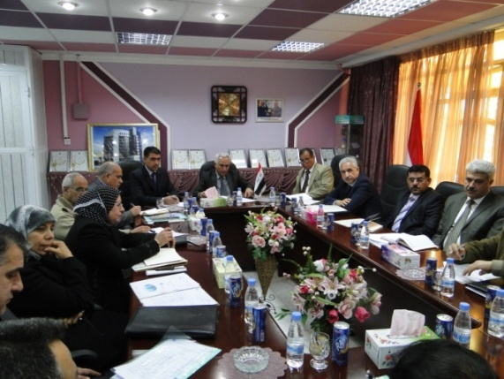
PRDC
International Cooperation Horizons
Joint researches with the following companies, Universities & organizations were started since mid.2010 :
A- JCCP
Study of corrosion problems in South oil fields (SOC, PRDC, WRPC,JCCP).

Slide 23
PRDC
International Cooperation Horizons
B- PRDC is the authorized office to represent IRAQ among OPEC countries representatives in the research field. PRDC leads the activities of 5 researching groups from all oil companies in the following main subjects;
1- Heavy Oil.
2- Carbon Management.
3- Gas Technology.
4- Clean Fuel.
5- Enhanced Oil Recovery (EOR).

Slide 24
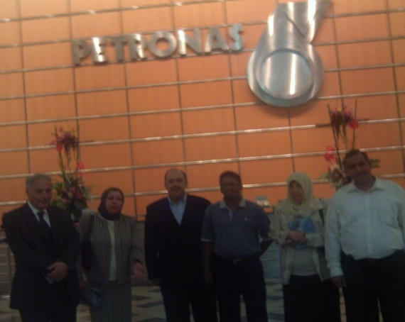
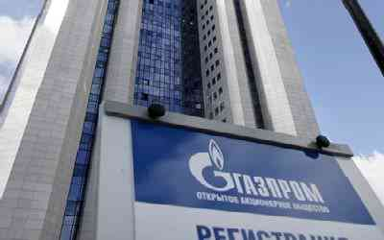
PRDC
International Cooperation Horizons
C- Luck oil company.
D- Schlumberger Company/ workshop about branched Horizontal Drilling.
E- PETRONAS Company
F- Gasbrome Company/ evaluation of environmental effects For Badrah oilfield.
G- Twente University.
H- GMI Company/ researches team from oil companies to construct drilling program development in Iraqi oilfields.
I- Shell Company/ Majnoon oilfield development.
J- Total Company/ Training program.
K- Petroskills Company/ Training program.
L- Maersk Oil Company/ Horizontal drilling technology.
M- ENI Company.
N- IMPA Company/ Developing old refineries.
0- Sonaugol Company / Environmental studies.
P- Gubkin University.
Q- GCI / Construction of chemical production factory.

Slide 25
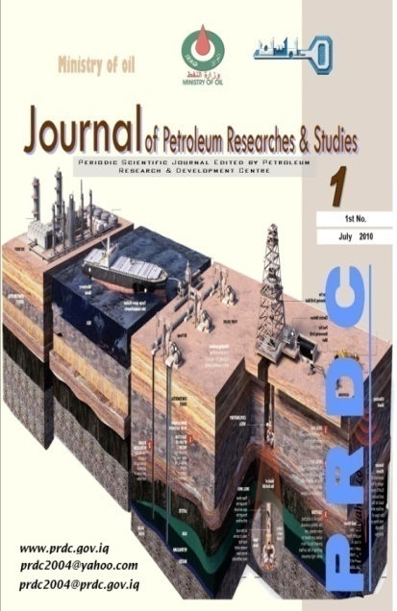
PRDC
Publications
The first & second numbers of seasonal periodic journal of “Petroleum researches & studies ".
"Catalysts in Iraqi petroleum industry” guide manual.
“Job description manual for PRDC".
“Hazardous materials used in oil industry “guide manual.
“Ion exchange (Resins)” a guide for water treatment.
“Chemicals guide used in petroleum companies & safety precautions”.

Slide 26
PRDC
Achieved Studies and Researches

Slide 27
PRDC
There are a growing up activities to the PRDC in studying and solving problems of the petroleum companies.
The achieved researches that carried out by the Corrosion unit in PRDC to the Iraqi oil companies can be represented as follows :

Slide 28
PRDC
Iraqi Patent No.2728
Corrosion Inhibitor for Well Acidizing Processes.
Iraqi Patent No.3203 in 27/ august /2006
Corrosion Inhibitor for Petroleum Industry.
Finding of Proper Solvent for Scale Removal in LPG Cylinder Valves.
Using Discharged Oil (after treating) as a Solvent to the Corrosion Inhibitor(that dissolves in oil).

Slide 29
PRDC
Studies & Problems from
Iraqi Oil Companies in 2011
Corrosion Unit Labs.

Slide 30
PRDC
Corrosion in the Float Roof of the Storage Tanks in SOC.
Study the Effect of H₂S Containing Environment on Alloys Used in Washing Tanks in Messan Oil Company (MOC) - Buzurgan Site .
Corrosion in the Production Units in Messan Fields - MOC

Slide 31
PRDC
Actual
Researches Suggested
in
PRDC

Slide 32
PRDC
Synthesis of Surface Active Agent as Corrosion Inhibitor
Extracting an active material from grenade peels and use it as an antioxidant additive to the coatings
Synthesis of Surface Active Agent from fatty acids
Preparation of Epoxy from fatty acids

Slide 33
PRDC
PRDC Ambitions

Slide 34
PRDC
1- فتح باب التعاون في مجال تبني مشروع البحوث المتعلقة بالتآكل في الصنـاعة النفطية بكـــــافة محـــــاورها (( الصناعة التحويلية والخزن والنقل وعمليات التكرير والتنقية والعمليات الاستخراجية )) من خلال مساهمة فرق بحثية مشتركة من الجامعة التكنولوجية ومركز البحث والتطوير النفطي .
2- اقامة دورات تدريبية تطويرية بين الجانبين .
3- ابرام العقود الاستشارية لاساتذة الجامعة التكنولوجية من ذوي الاختصاص ( بشقيه عقد تنفيذ مهممة او عقد استشاري شهري).
4- فتح باب التعاقد مـــع طلبة الدراسات العليا في موضوع مشاكل ومعالجة التآكل في الصنــاعة النفطية (Ph.D, M.Sc).
5- فتح باب التعاون في مجال التطبيق العملي لطلبة المراحل المنتهية في اقسام هندسة الانتاج والمعادن والهندسة الكيمياوية والاقسام العلمية غير الهندسية.

Slide 35
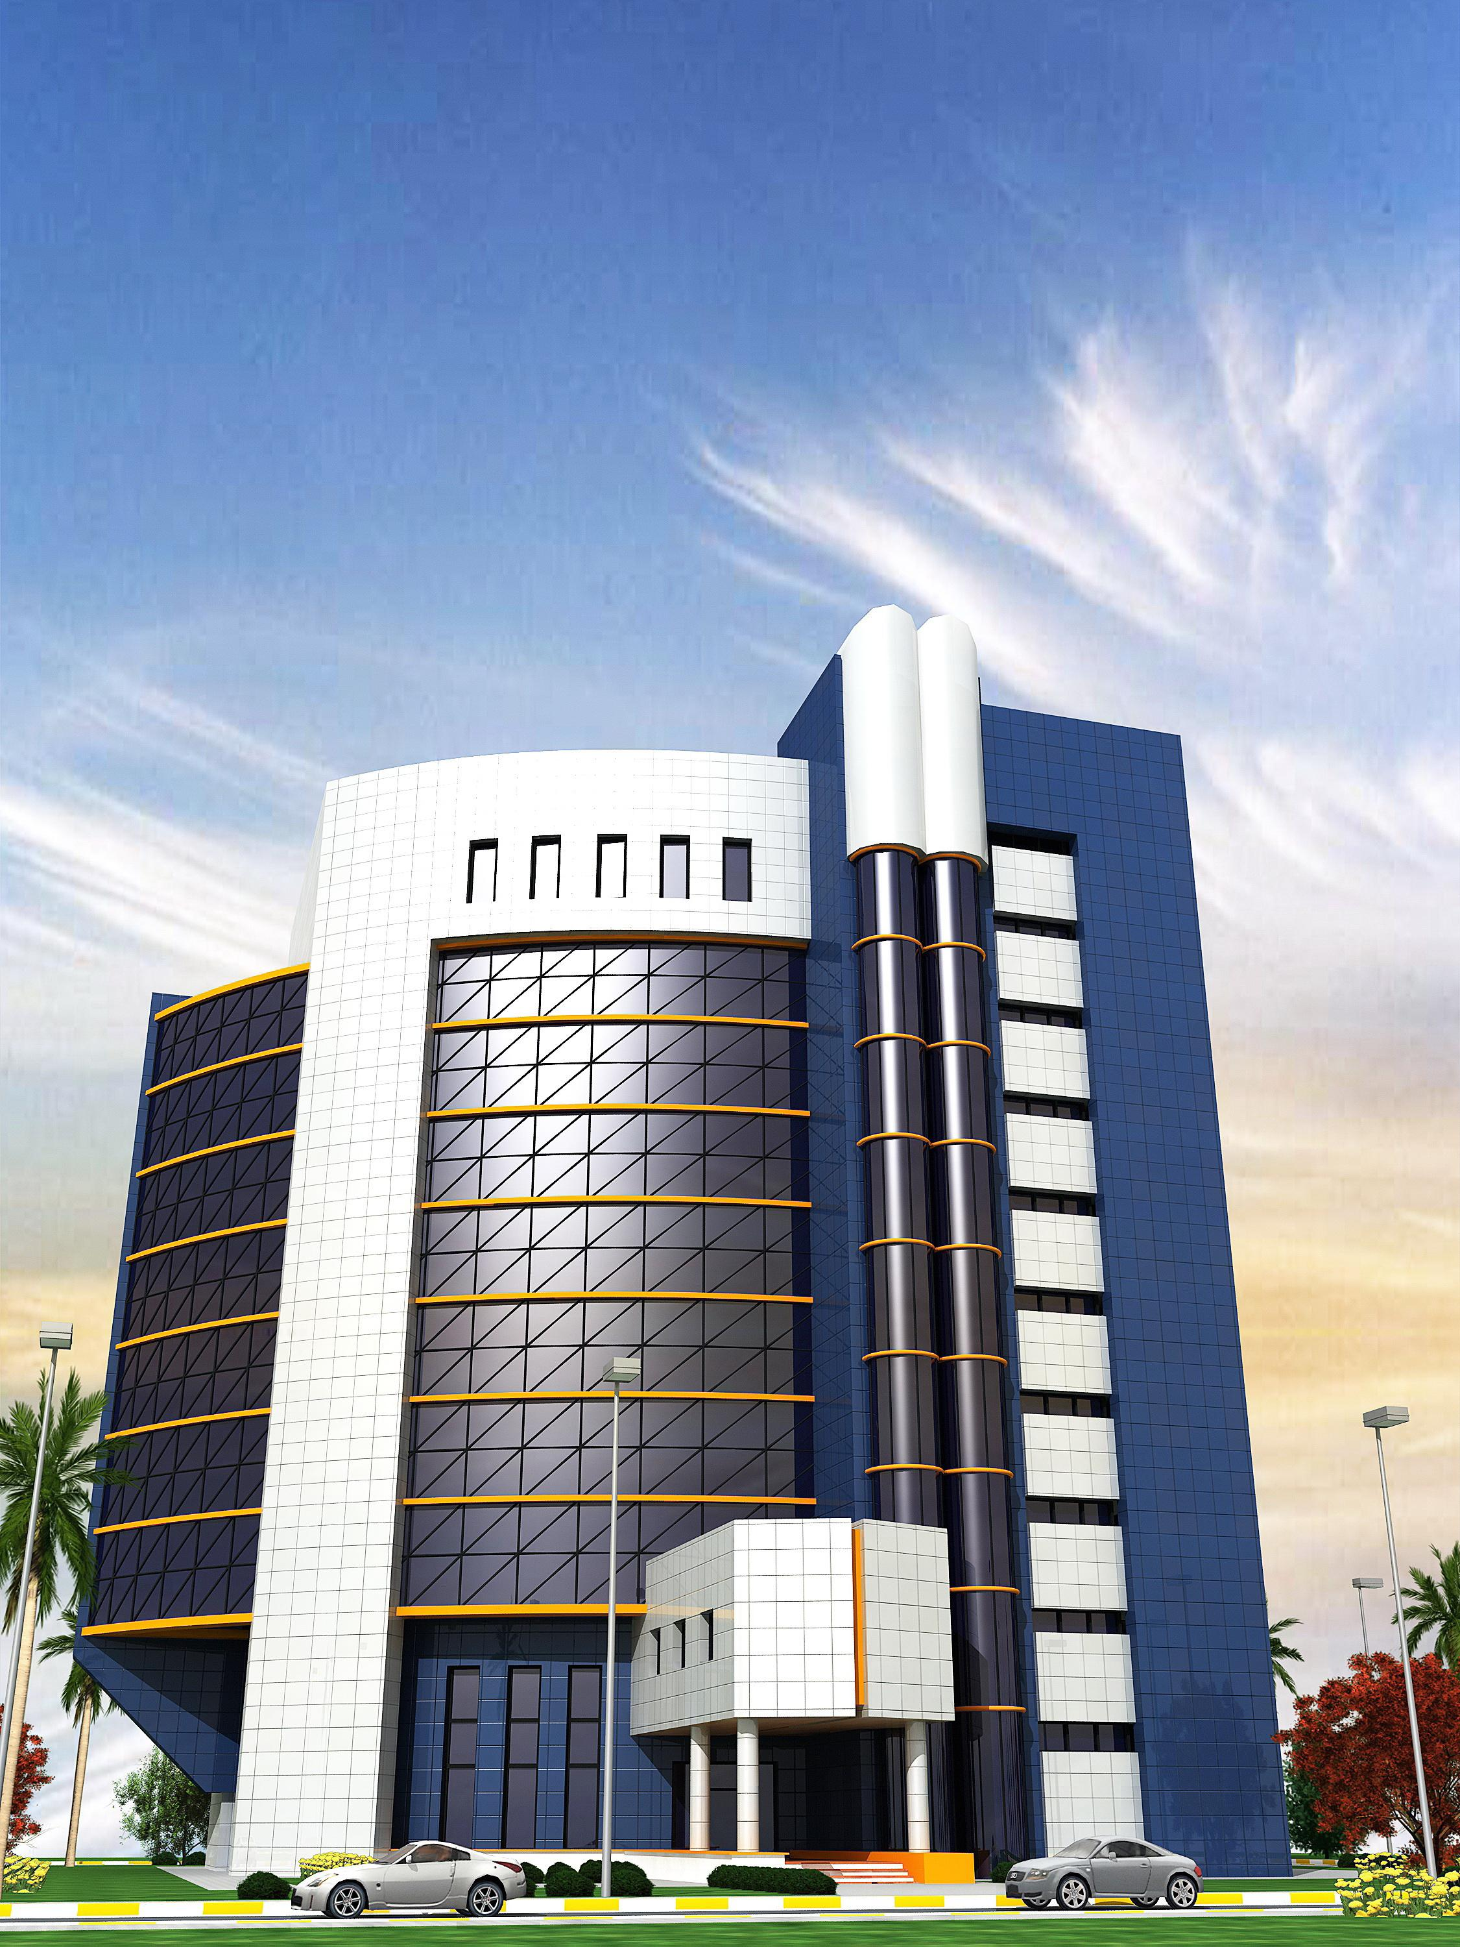
PRDC
Thank you

