Slide 1
REPUBLIC OF IRAQ
MINISTRY OF HIGHER EDUCATION &
SCIENTIFIC RESEARCH
UNIVERSITY OF TECHNOLOGY
PRODUCTION & METALLURGY ENG. DEP.
EFFECT OF CURRENT ON ELECTRICAL DISCHARGE MACHINING ( EDM )
تأثير التيار الكهربائي على عملية التشغيل بالشرارة الكهربائية
Prepared by
EDREES ABD ALI KHUDHAIR MUSTAFA MOHSEN KHUDER
أدريس عبد علي خضير
مصطفى محسن خضر
Supervise by
Dr. Shukry H. Aghdeab
2010 - 2011

Slide 2
Abstract
Electric discharge machining one of the most extensively used non-conventional material removal processe. The principle of electric spark is used in this thesis to generate high electrical discharge at high currents.
The machine in the experimental work for EDM system has been built to cutting conductivity metals and using power supply (RC type) ,capacitor and dielectric solution, the work piece and electrode are conductivity metals like (copper ).

Slide 3
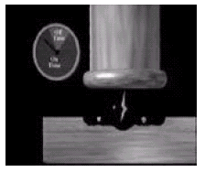
Introduction
Electrical Discharge Machining (EDM) is a thermal erosion process in which an electrically generated spark vaporizes electrically conductive material as shown in Fig.(1) EDM is one of the most extensively used non-conventional material removal processes . Both electrode (tool) and workpiece must be electrically dielectric solution between the tool
fig1
and workpiece. The process removes metal via electrical and thermal energy, having no mechanical contact with the workpiece . Its unique feature of using thermal energy is to machine electrically conductive parts regardless of their hardness; its distinctive advantage is in the manufacture of mould, die, automotive, aerospace and other applications. In addition, EDM does not make direct contact between the electrode and the workpiece, eliminating mechanical stresses, chatter and vibration problems during machining.

Slide 4
EXPERMENTAL WORK AND RESULTS
Mechanism
Power supply
Dielectric solution
Work piece
Tool-Electrode

Slide 5
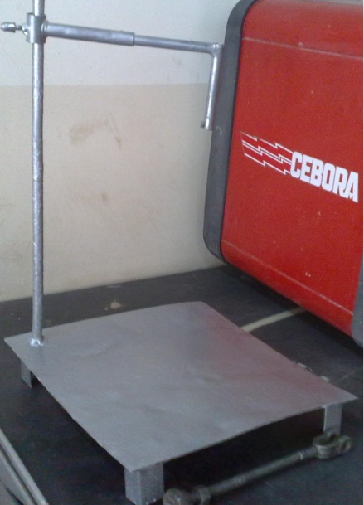
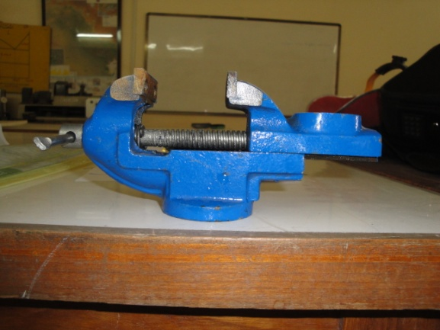
Mechanism
Mechanism was used in this work ( local made) as shown in fig.(2)which include :
Base made of ( low carbon steel) 300*350 mm .as shown in fig.
Guide ( cylindrical shape with Ф 10 * 50 mm ) welding on the base .
Tool holder ( aluminum bar Ф 12 * 120 two no. ) the relative motion of this tool holder are sliding on the guide and locked by bolt to insure the vertical motion.
Work piece holder as shown in fig.(3).
Fig 2
Fig 3

Slide 6
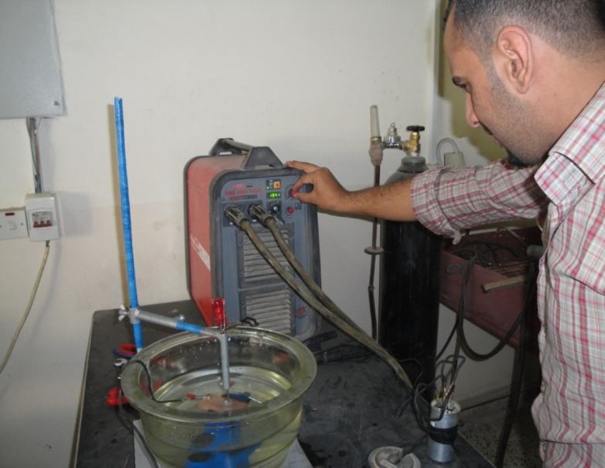
Power supply
The source of power for the experimental work is the generator power supply. The EDM power supply unit also operates with manual control. Manual control is more or less a feedback loop, as information is fed to the controller from the workpiece; the controller is able to change its inputs thus affecting the workpiece.
Fig 4
The unit used AC 380V input voltage contains (three phase), and output voltage 70V (two phase), but are available with other currents like 10 -200A. A generator for the experimental work unit used is available in welding machine (50/60HZ) type MMA 4040/ T- cell (Cebora-Italian). Generator current range is (10-400A) depending on industrial application, as shown in fig.(4)

Slide 7
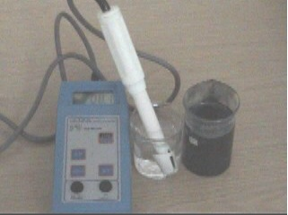
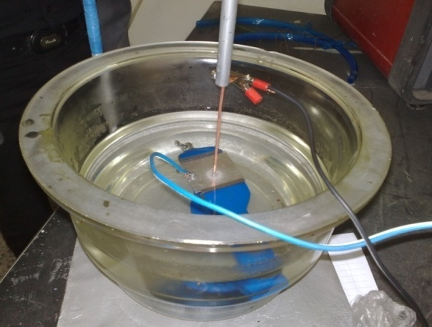
Dielectric solution
Dielectric solution is the distilled water is water that has many of its impurities removed through distillation involves boiling the water and then condensing the steam into a clean container. distilled water can transport the high spark current between the tool-electrode and workpiece for conducting the sparks by breaking down at the appropriate applied voltage. Secondly, the dielectric solution flushes out the chips from the machined area, and finally, the dielectric reduces temperature of the workpiece. Electrode Instrument Meter is used in measurements of PH (Hydrogen Power)= 7.0 ph , the device model HI 9811 (Hanna Portable Instruction Manual), as shown in fig(5). and fig.(6) as shown the Pyrex container .
Fig 5
Fig 6

Slide 8
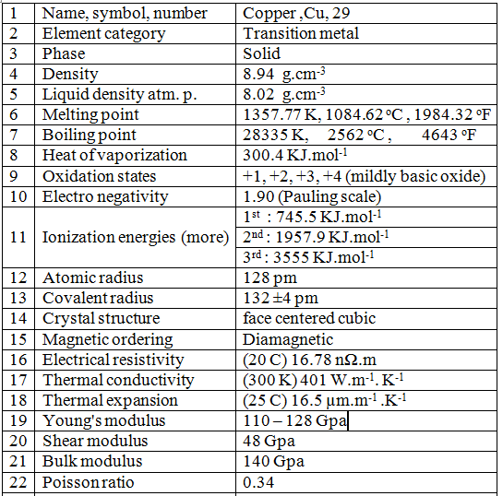
Work piece
The workpiece used was made of copper, general Properties of workpiece.
The chemical composition to the workpiece.
95 % Cu
3 % Zn
2 % Fe
Table 1

Slide 9
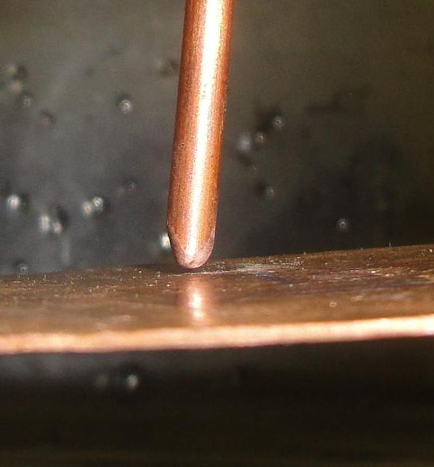
Tool-Electrode
The tool used was made of copper with constant diameter(Ф 3.5 mm). and have the same properties of workpiece, see Table(of workpiece) and the mechanical composition of workpiece as shown in fig.(7) and fig.(8).
Fig 7
Fig 8

Slide 10
Practical experimental
first experimental
Second experimental
Third experimental
Fourth experimental
Fifth experimental
Extra experimental

Slide 11
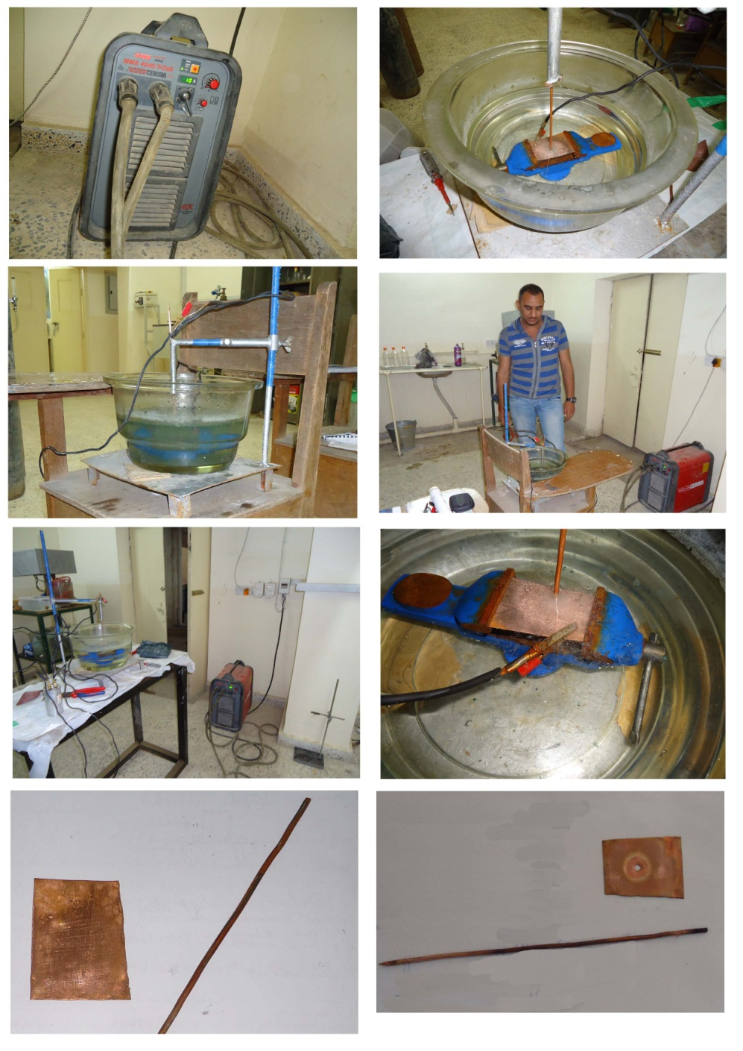
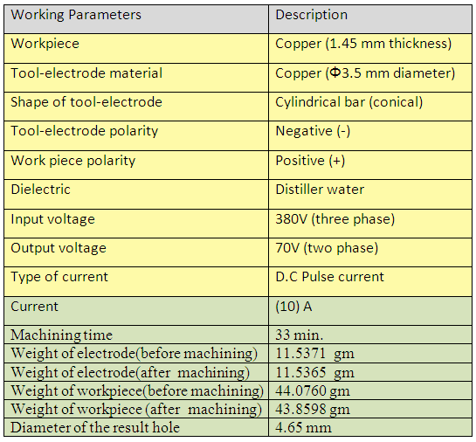
First experimental
Table 2
Fig 9

Slide 12
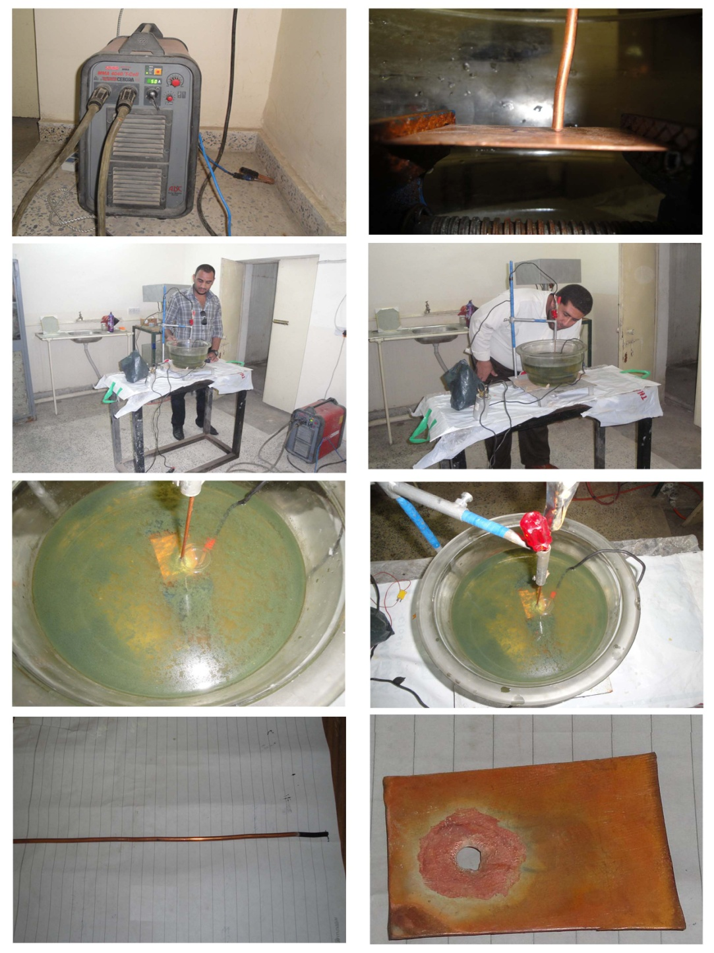
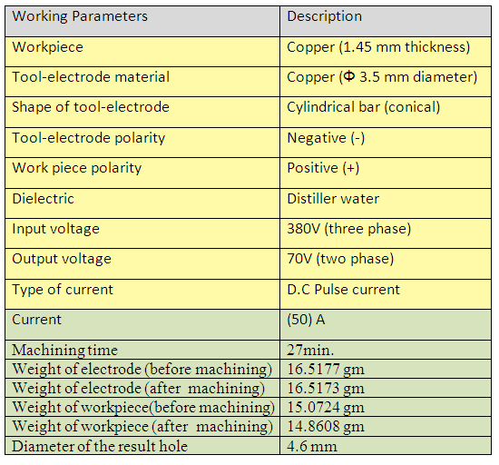
Second experimental
Table 3
fig10

Slide 13
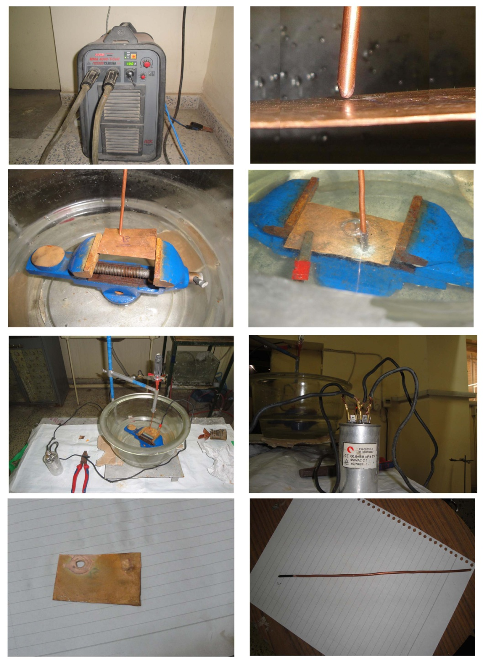
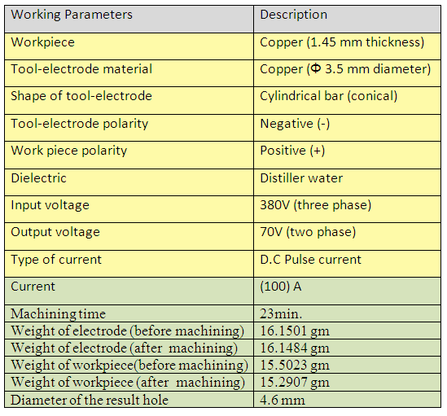
Third experimental
Table 4
Fig 11

Slide 14
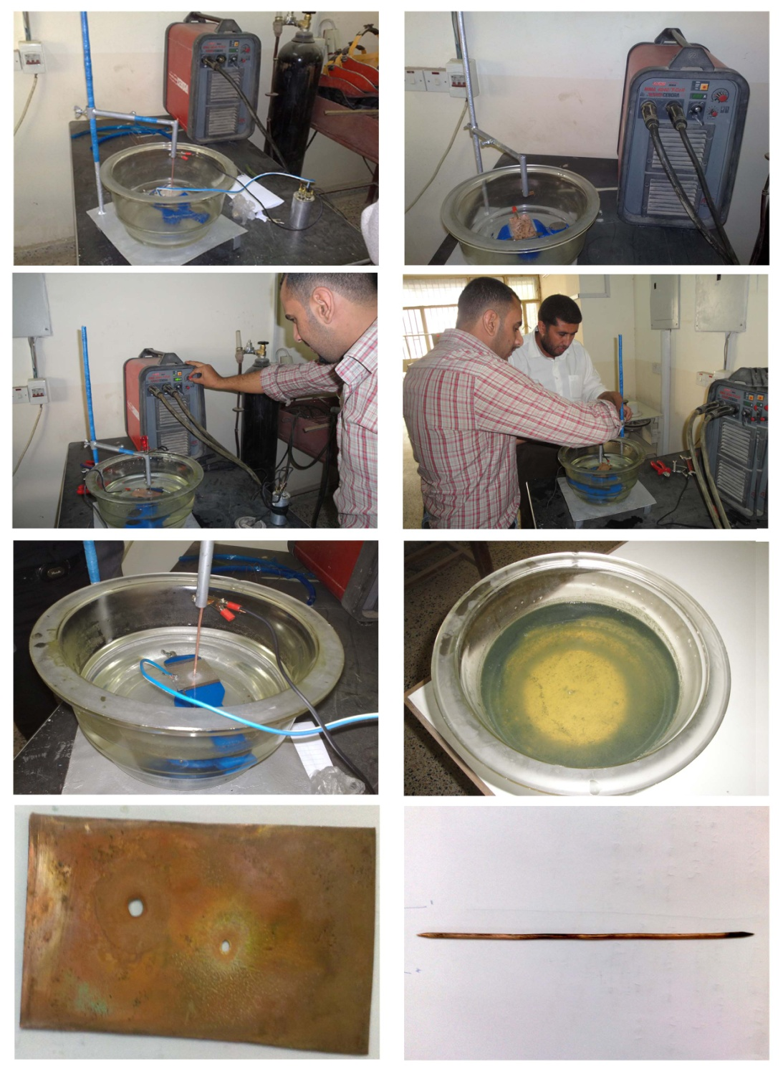
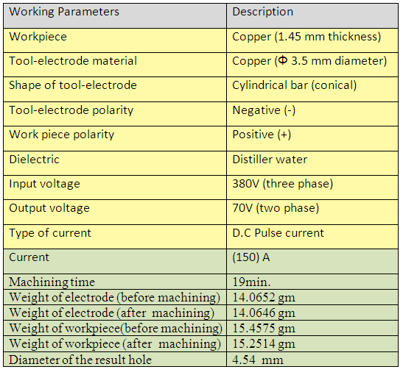
Fourth experimental
Table 5
Fig 12

Slide 15
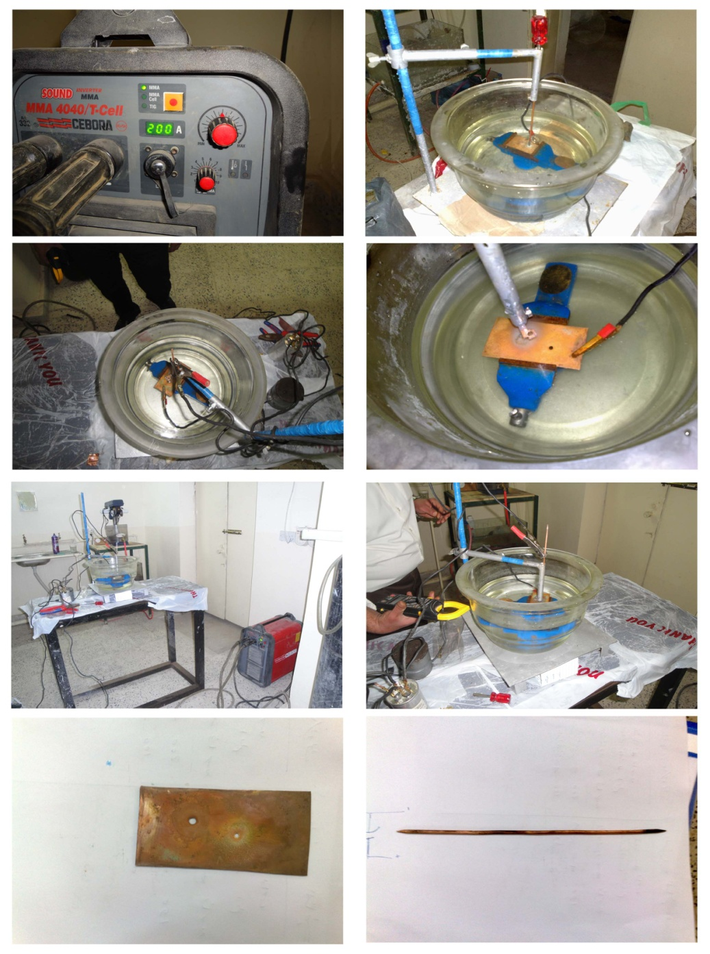
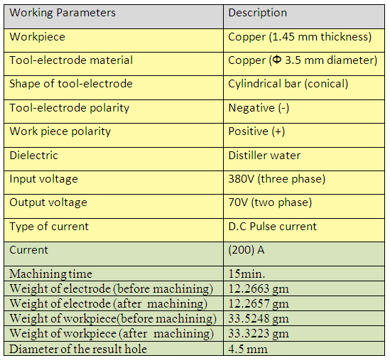
Fifth experimental
Table 6
Fig 13

Slide 16
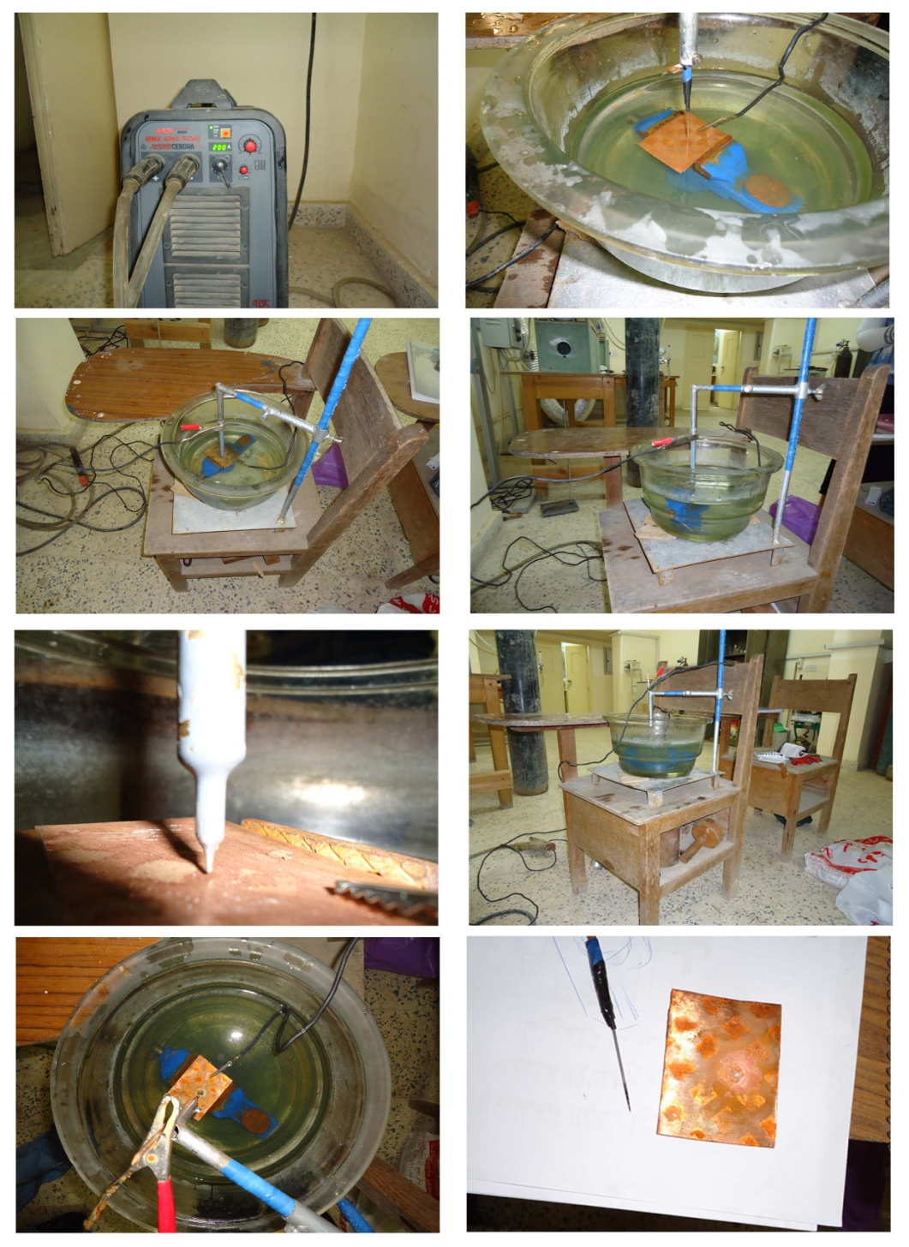
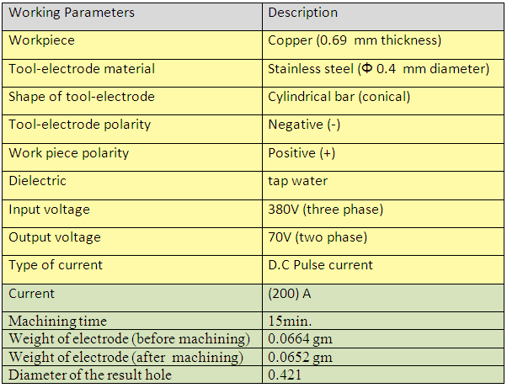
1st extra experimental
Table 7
Fig 14

Slide 17
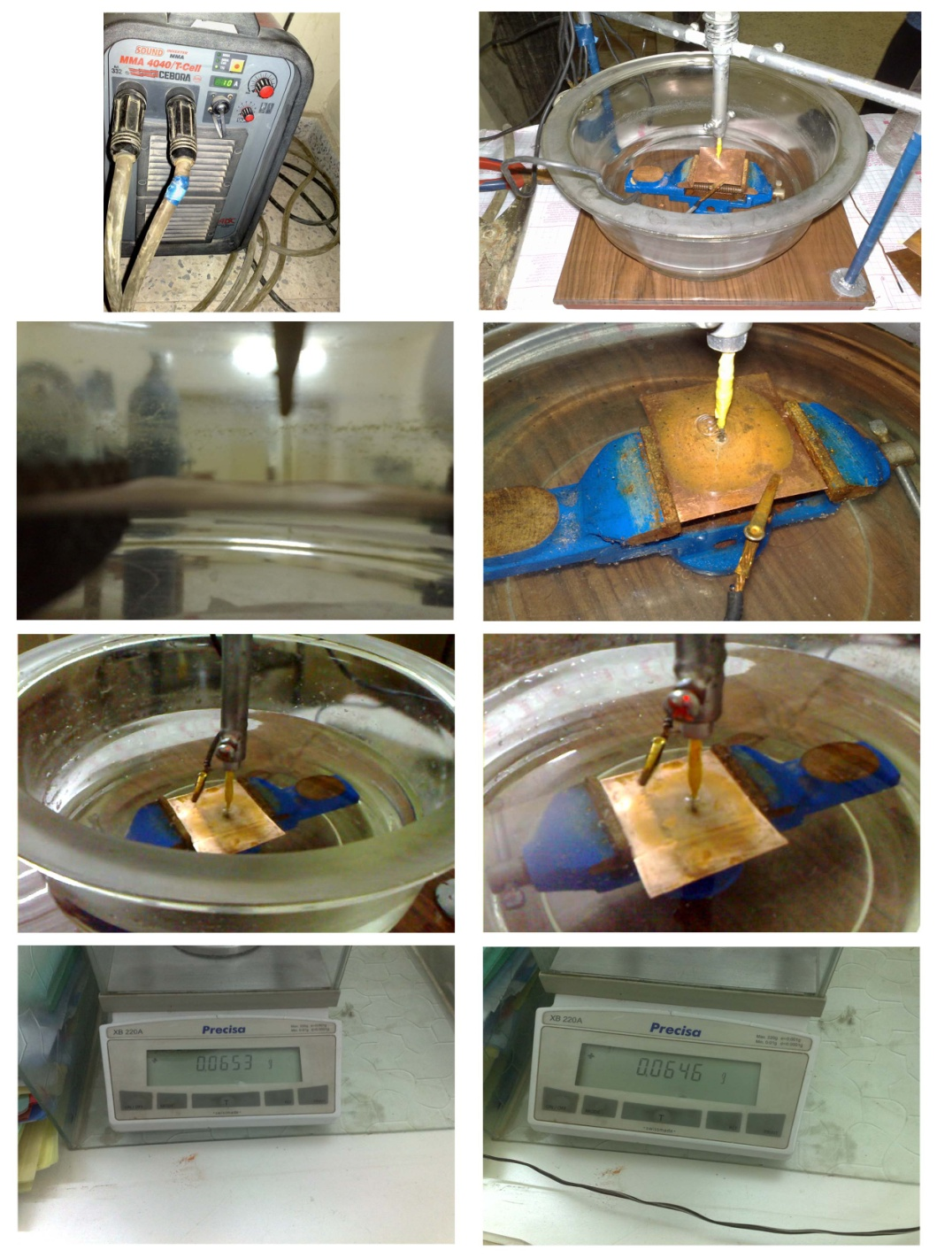
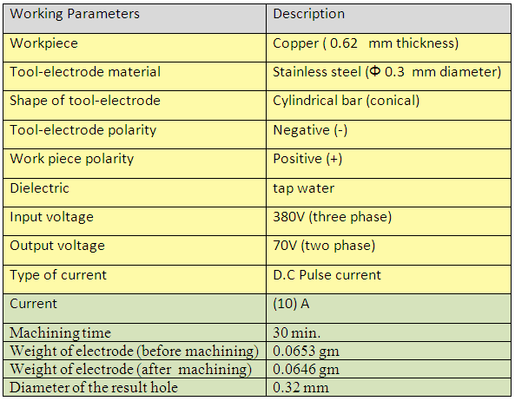
2nd extra experimental
Table 8
Fig 15

Slide 18
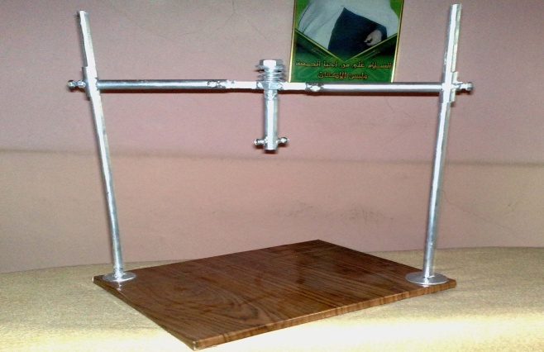
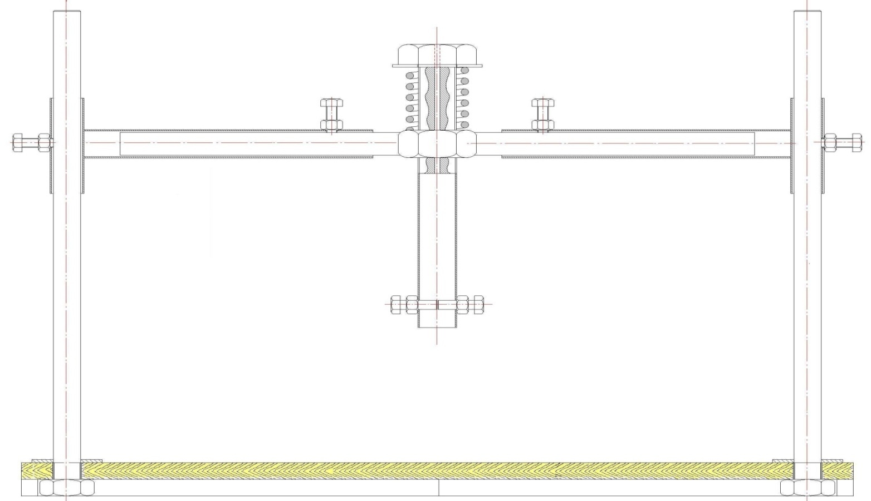
Developed the mechanism
After 5th experimental work we are limitation the error which meet us and possibility to avoid it , we were designed and manufactured anew mechanism as shown in fig.(16) and fig.(17).
Fig 16
Fig 17

Slide 19
The computations
the machining time
the material removal rate
the electrode wear (EW)

Slide 20
The machining time
From the experimental work results we can draw the relationship between the machining time and the current as shown in table(9) and fig.(18).
Table 9
Fig 18

Slide 21
The material removal rate (MRR).
We can calculating the material removal rate by using the equation which equal the volume of removal metal from workpiece over the machining time , with constant thickness of workpiece (1.45 mm) and variety current (10,50,100,150 and 200 A) as shown in table(10) and fig.(19)
Table 10
Fig 19

Slide 22
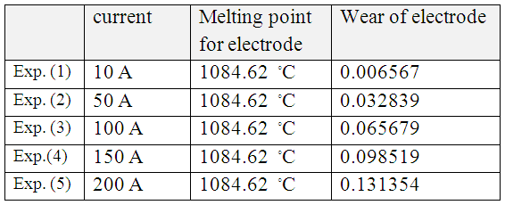
The electrode wear
We can calculating the electrode wear by using the equation which equal the current value multiply the melting point over (- 2.38) multiply the constant 11000 , with variety current (10,50,100,150 and 200 A) as shown in table (11) and fig.(20).
Wear of electrode = 11000 * I * Tt^{-2.38}
Table 11
Fig 20

Slide 23
DISCUSSION
CONCLUSIONS
RECOMMENDATION FOR FUTURE WORK

Slide 24
Discussion
the discussion of results obtained from experimental work. This discussion concentrates mainly on the effect of machining time on the current, as shown in fig(18). at copper workpiece thickness (1.45 mm) with varying currents (10,50,100,150 and 200 A). Fig.(18) show that the machining time decreases with increases the current due to increases the spark number and material removal rate increases with increases the current resulting in greater amount of spark generation in the sparking zone , which in turn increases the material removal and electrode wear as shown in fig.(19) and fig.(20) respectively.

Slide 25
Conclusions
The main conclusion which can be deduced from the experimental work can be summarized as follows:
EDM system has been built for this purpose .
The results for the MRR in this method are about (0.74581 - 1.53663 mm³/min).
The results for the wear of electrode between (0.006567 - 0.131354).
The material removal and electrode wear increases in current.

Slide 26
Recommendation for future work
The following research points maybe suggested for future work:
Studying the effect of cutting other materials like Al and steel.
Using other dielectric solution such as oil.
Using other tool electrode materials such as steel and carbon.
Studying the surface roughness in the current of EDM.

Slide 27
References
1- Lotfi, K., G., Electrical Discharge Machining (EDM), the American University in Cairo, Department of Mechanical Engineering, Vol. 202, 2003.
2- Ho, K., H., and Newman, S., T., State of the art electrical discharge machining (EDM), International Journal of Machine Tools and Manufacture, Vol. 43, pp. 1287-1300, 2003.
3- John, E., F., Electrical discharge machining, Rockwell International, ASM Metals Handbook, Vol. 16 Machining, pp. 557-564, 1997.
4- Margaret, H., C., Environmental Constituents of Electrical Discharge Machining, thesis Submitted to the Department of Mechanical Engineering, Massachusetts Institute of Technology, 2004.
5- Pandey, P., C., and Shan, H., S., Modern machining processes, University of Roorkee, New Delhe, Chapter 4, pp.84-113, 1980.
6- Hassan, El- Hoffy, Advanced Machining Processes, Chapter 5, pp.115-140, by McGraw-Hill Company, 2005.
7- Gisbert, L., Advantages of the New EDM and HSM Technology, Agie Chamilles Group, pp. 1-34, 2005.
8- Aghdeab, SH., H., Experimental and numerical investigation of cutting non-conducting materials by EDM/ESM technique, Ph.D. Thesis, University of Technology- Iraq, Chaps. 1 and 4, 2008.

